Slide 1
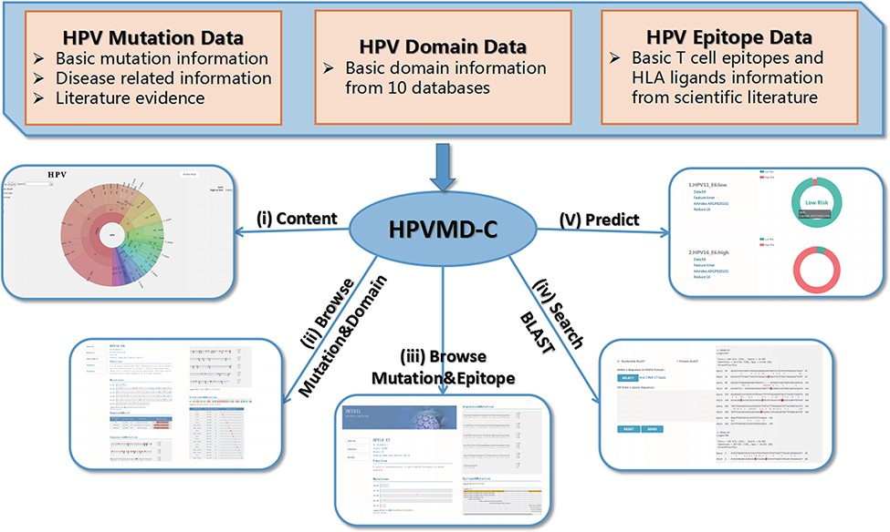
Figure 1. An overview of HPVMD-C 1.0: (i) Distribution of mutation content among the protein sequences, the domains and ...
Notes:
Figure 1. An overview of HPVMD-C 1.0: (i) Distribution of mutation content among the protein sequences, the domains and the epitopes; (ii) Distribution of the mutations among the domains; (iii) Distribution of the mutations among the epitopes; (iv) Mutation detection using BLAST; (v) Risk type prediction using the characteristics of amino acids and the SVM.
Unless provided in the caption above, the following copyright applies to the content of this slide: © The Author(s) 2022. Published by Oxford University Press.This is an Open Access article distributed under the terms of the Creative Commons Attribution License (https://creativecommons.org/licenses/by/4.0/), which permits unrestricted reuse, distribution, and reproduction in any medium, provided the original work is properly cited.

Slide 2
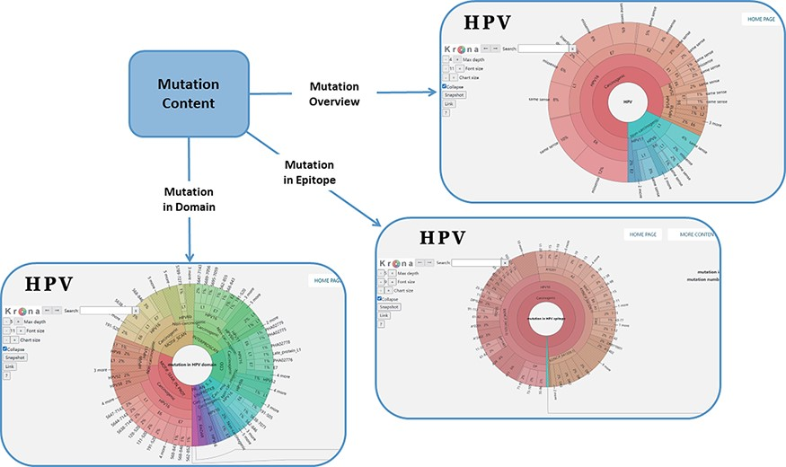
Figure 2. Distribution of mutation content among the whole sequences, the domains and the epitopes; the parameters on ...
Notes:
Figure 2. Distribution of mutation content among the whole sequences, the domains and the epitopes; the parameters on the left can adjust the display of the pie chart.
Unless provided in the caption above, the following copyright applies to the content of this slide: © The Author(s) 2022. Published by Oxford University Press.This is an Open Access article distributed under the terms of the Creative Commons Attribution License (https://creativecommons.org/licenses/by/4.0/), which permits unrestricted reuse, distribution, and reproduction in any medium, provided the original work is properly cited.

Slide 3
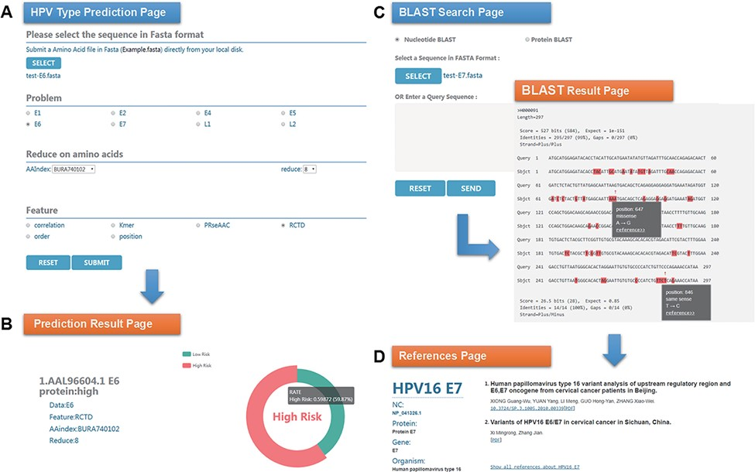
Figure 3. An example of HPVMD-C 1.0 usage: (A) Prediction page—Select optimal parameters: ‘E6’ data set, beta ...
Notes:
Figure 3. An example of HPVMD-C 1.0 usage: (A) Prediction page—Select optimal parameters: ‘E6’ data set, beta propensity characteristic index ‘BURA740102’, reduction number 8 and ‘RCTD’ feature; submit and get the result (B); (C) Blast search page and the result page—Use arrow to mark points that are different from the query sequence and highlight the mutation about this sequence in red; using mouse to slide over a mutation will pop up a detail box; references result page (D) will be displayed by clicking the references link.
Unless provided in the caption above, the following copyright applies to the content of this slide: © The Author(s) 2022. Published by Oxford University Press.This is an Open Access article distributed under the terms of the Creative Commons Attribution License (https://creativecommons.org/licenses/by/4.0/), which permits unrestricted reuse, distribution, and reproduction in any medium, provided the original work is properly cited.

Slide 4
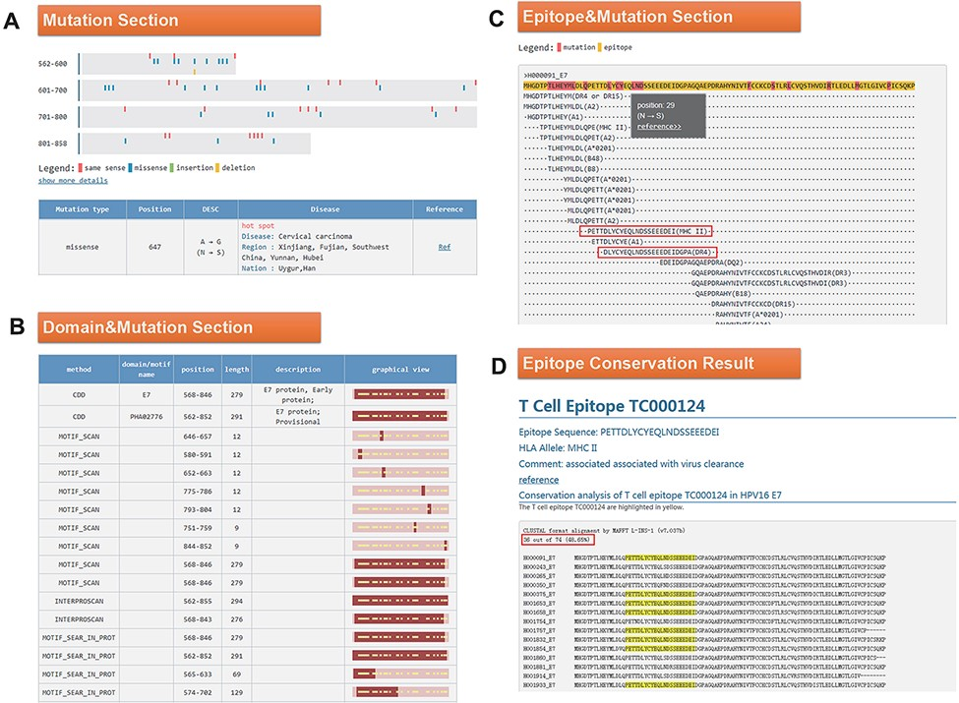
Figure 4. (A) Mutation section in ‘Detail’ page: Use visualization techniques to show the position and type of ...
Notes:
Figure 4. (A) Mutation section in ‘Detail’ page: Use visualization techniques to show the position and type of mutations; related diseases, races, regional information and literature links are also listed; (B) Domain section in detail page: In the graphical view, bar represents the entire sequence, dark part represents the domain or motif and dots represent the mutation; (C) Epitope section in detail page: The second line shows the entire sequence, light part highlights the epitope and dark part highlights the mutation; inside two boxes are the epitopes containing N29S; (D) Epitope conservation result page: The query epitope TC000124 are highlighted; the conservation rate is 48.65%.
Unless provided in the caption above, the following copyright applies to the content of this slide: © The Author(s) 2022. Published by Oxford University Press.This is an Open Access article distributed under the terms of the Creative Commons Attribution License (https://creativecommons.org/licenses/by/4.0/), which permits unrestricted reuse, distribution, and reproduction in any medium, provided the original work is properly cited.

