Slide 1
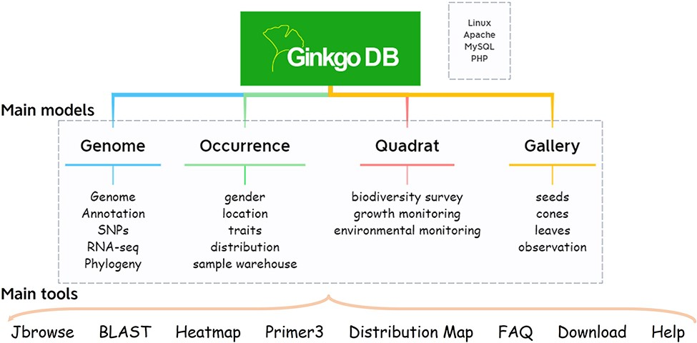
Figure 1. Database architecture of GinkgoDB.
Notes:
Figure 1. Database architecture of GinkgoDB.
Unless provided in the caption above, the following copyright applies to the content of this slide: © The Author(s) 2022. Published by Oxford University Press.This is an Open Access article distributed under the terms of the Creative Commons Attribution-NonCommercial License (https://creativecommons.org/licenses/by-nc/4.0/), which permits non-commercial re-use, distribution, and reproduction in any medium, provided the original work is properly cited. For commercial re-use, please contact journals.permissions@oup.com

Slide 2
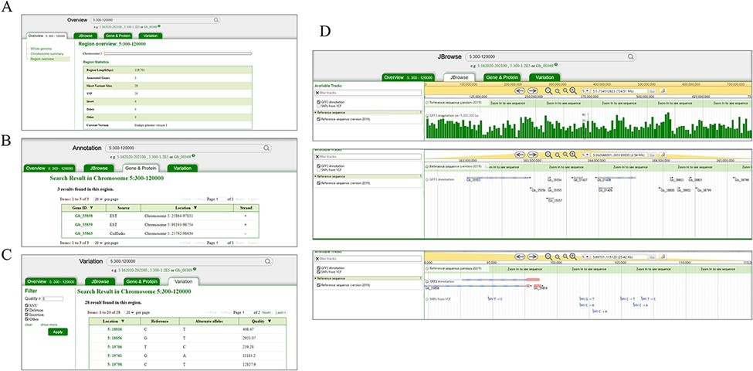
Figure 2. Search and result pages of GinkgoDB. Users can take a query for the specific genome segment or gene, which ...
Notes:
Figure 2. Search and result pages of GinkgoDB. Users can take a query for the specific genome segment or gene, which would return the summary (A), all the gene (B) and SNPs (C) of the queried region, a link to the JBrowse page (D).
Unless provided in the caption above, the following copyright applies to the content of this slide: © The Author(s) 2022. Published by Oxford University Press.This is an Open Access article distributed under the terms of the Creative Commons Attribution-NonCommercial License (https://creativecommons.org/licenses/by-nc/4.0/), which permits non-commercial re-use, distribution, and reproduction in any medium, provided the original work is properly cited. For commercial re-use, please contact journals.permissions@oup.com

Slide 3
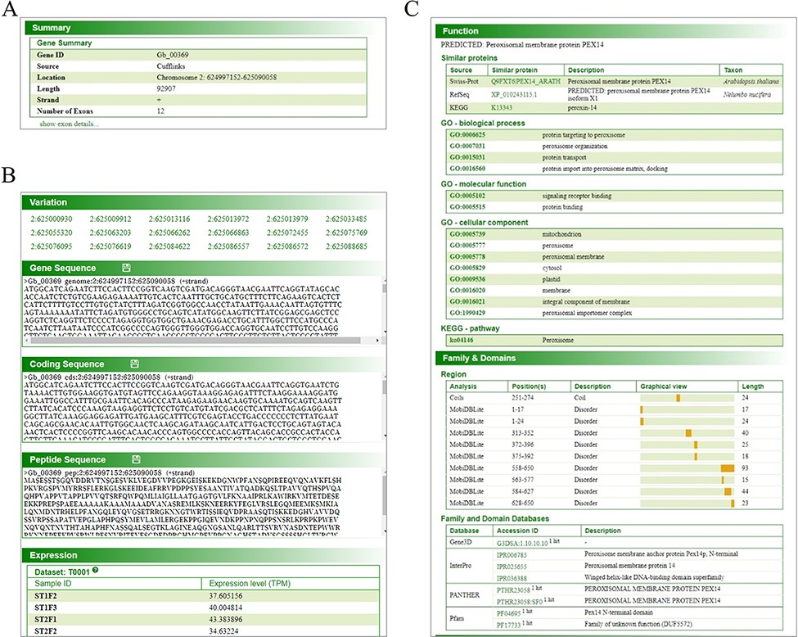
Figure 3. Gene page of GinkgoDB. The gene page displays specific gene summary (A), sequence, translated protein ...
Notes:
Figure 3. Gene page of GinkgoDB. The gene page displays specific gene summary (A), sequence, translated protein sequence, expression (transcripts per million, TPM) (B) and annotation information (C), in each collected sample.
Unless provided in the caption above, the following copyright applies to the content of this slide: © The Author(s) 2022. Published by Oxford University Press.This is an Open Access article distributed under the terms of the Creative Commons Attribution-NonCommercial License (https://creativecommons.org/licenses/by-nc/4.0/), which permits non-commercial re-use, distribution, and reproduction in any medium, provided the original work is properly cited. For commercial re-use, please contact journals.permissions@oup.com

Slide 4
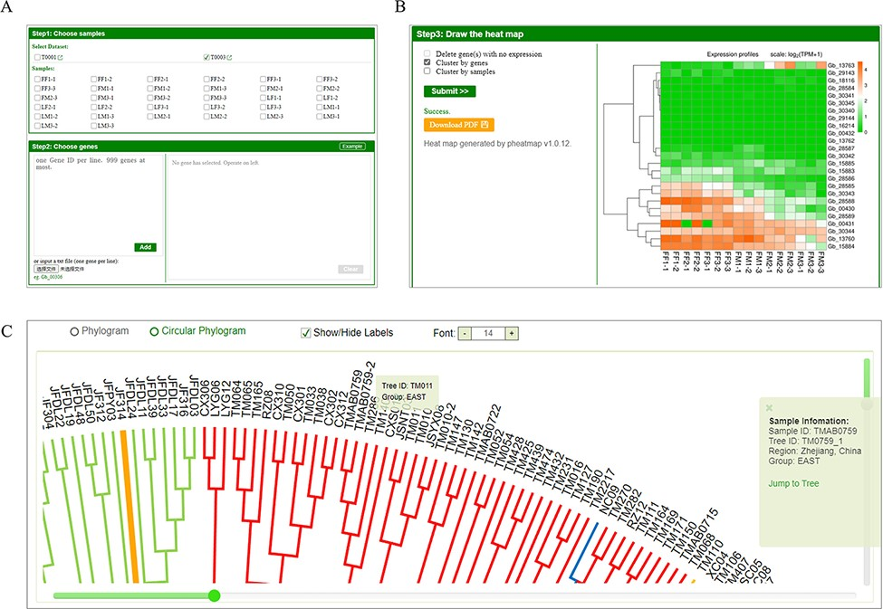
Figure 4. Expression analysis tool and phylogeny of GinkgoDB. Users can select specific sample combinations for the ...
Notes:
Figure 4. Expression analysis tool and phylogeny of GinkgoDB. Users can select specific sample combinations for the traits under study to analyze the expression differences of target genes among different experiments (A), which will be visualized by an expression heatmap, which could be downloaded as PDF(B). (C) The neighbor-joining phylogeny tree of wild individuals. Each sample ID could be clicked and links to the sample information page.
Unless provided in the caption above, the following copyright applies to the content of this slide: © The Author(s) 2022. Published by Oxford University Press.This is an Open Access article distributed under the terms of the Creative Commons Attribution-NonCommercial License (https://creativecommons.org/licenses/by-nc/4.0/), which permits non-commercial re-use, distribution, and reproduction in any medium, provided the original work is properly cited. For commercial re-use, please contact journals.permissions@oup.com

Slide 5
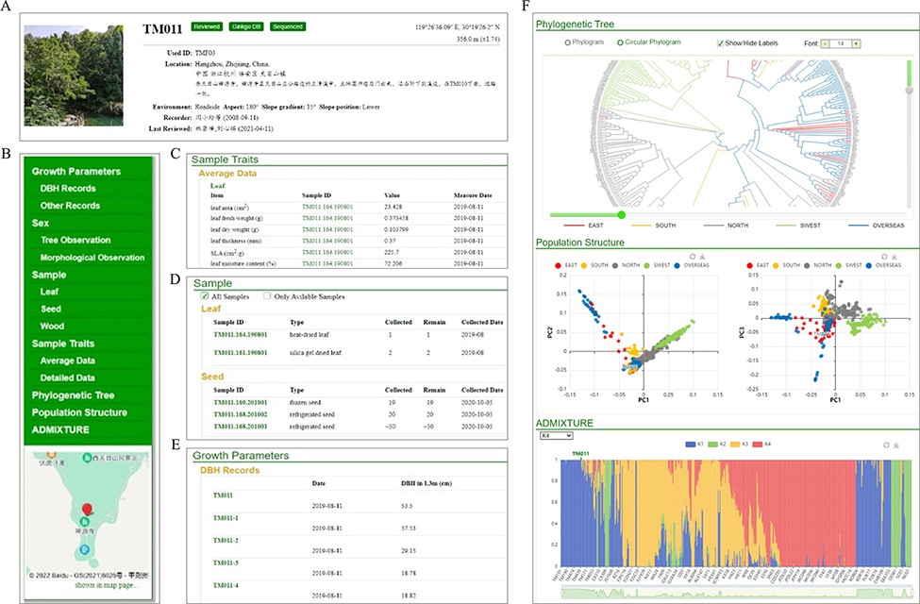
Figure 5. Individual page with detail information of GinkgoDB. (A) Summary. (B) Content list with location tagged on ...
Notes:
Figure 5. Individual page with detail information of GinkgoDB. (A) Summary. (B) Content list with location tagged on the map. (C) Sample traits if available. (D) Biological materials collection of the individual. (E) Integrated visualization of phylogeny, PCA and population structure.
Unless provided in the caption above, the following copyright applies to the content of this slide: © The Author(s) 2022. Published by Oxford University Press.This is an Open Access article distributed under the terms of the Creative Commons Attribution-NonCommercial License (https://creativecommons.org/licenses/by-nc/4.0/), which permits non-commercial re-use, distribution, and reproduction in any medium, provided the original work is properly cited. For commercial re-use, please contact journals.permissions@oup.com

Slide 6
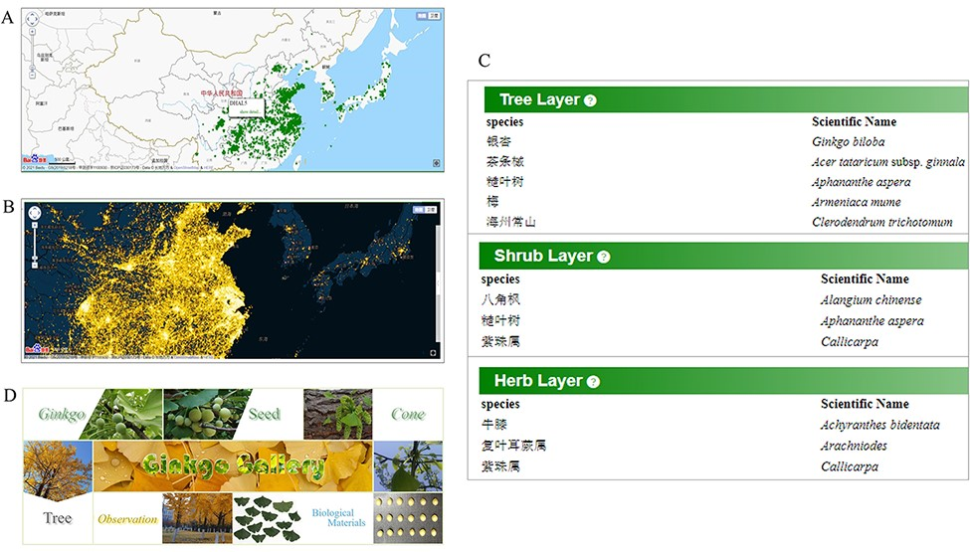
Figure 6. Comprehensive data for ginkgo conservation. Distribution map (A) of documented mature trees and heatmap (B) ...
Notes:
Figure 6. Comprehensive data for ginkgo conservation. Distribution map (A) of documented mature trees and heatmap (B) of reported trees. (C) Species list in each quadrat. (D) The gallery model collects various material type of trees.
Unless provided in the caption above, the following copyright applies to the content of this slide: © The Author(s) 2022. Published by Oxford University Press.This is an Open Access article distributed under the terms of the Creative Commons Attribution-NonCommercial License (https://creativecommons.org/licenses/by-nc/4.0/), which permits non-commercial re-use, distribution, and reproduction in any medium, provided the original work is properly cited. For commercial re-use, please contact journals.permissions@oup.com

