Slide 1
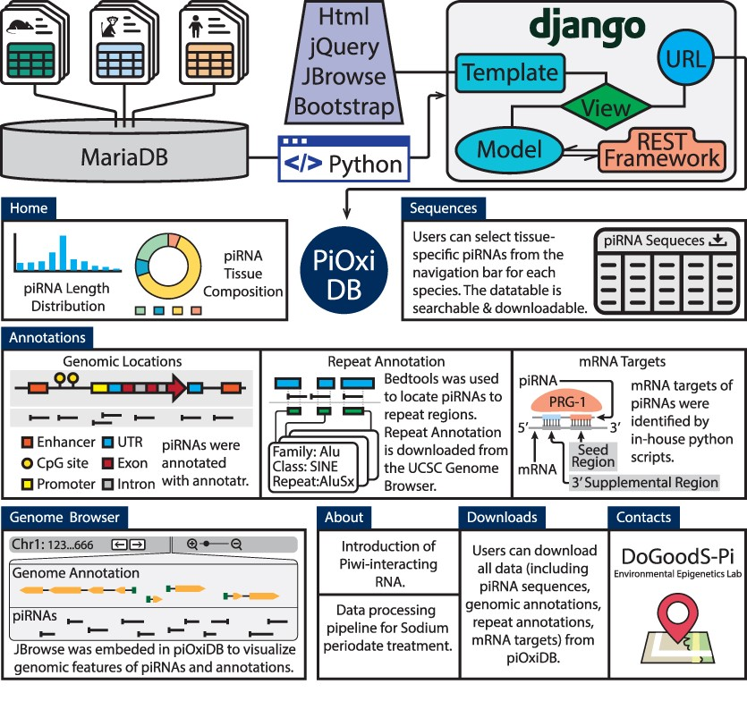
Figure 2. The piOxi DB website includes mouse, macaque and human piRNA data. Data were stored in MariaDB. Django with ...
Notes:
Figure 2. The piOxi DB website includes mouse, macaque and human piRNA data. Data were stored in MariaDB. Django with the REST framework was used to establish the webserver. JQuery, JBrowse and Bootstrap were used in implementing the frontend. The ‘Homepage’ includes a brief introduction and species-specific summary, including piRNA length distributions (histogram) and tissue compositions (pie chart). A representative table is included within the ‘Sequences’ that contains tissue-specific piRNA data for each species. The ‘Annotations’ tables indicate specific genomic locations, repeats and potential mRNA targets for the piRNA sequences found within piOxi DB. The ‘Browser’ function of piOxi DB allows the users to visualize the piRNA sequences of piOxi DB, relative to their corresponding genomic annotations. The ‘About’ section provides a brief introduction about piRNA, followed by ‘Downloads’ for data extrapolation and ‘Contacts’. Alt text: User-friendly features and utilities incorporated within piOxi DB.
Unless provided in the caption above, the following copyright applies to the content of this slide: © The Author(s) 2024. Published by Oxford University Press.This is an Open Access article distributed under the terms of the Creative Commons Attribution License (https://creativecommons.org/licenses/by/4.0/), which permits unrestricted reuse, distribution, and reproduction in any medium, provided the original work is properly cited.

