Slide 1
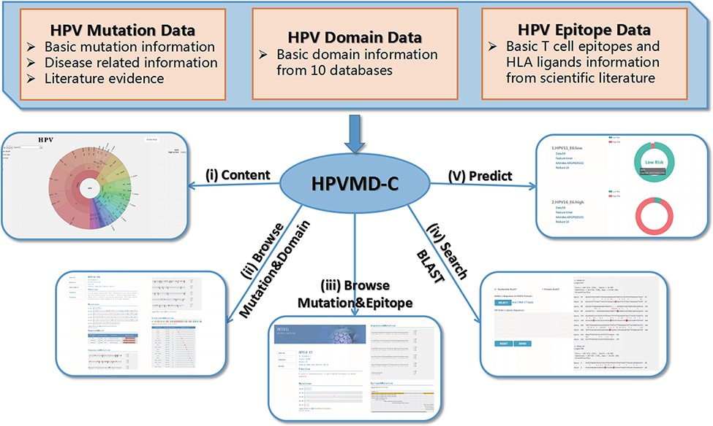
Figure 1. An overview of HPVMD-C 1.0: (i) Distribution of mutation content among the protein sequences, the domains and ...
Notes:
Figure 1. An overview of HPVMD-C 1.0: (i) Distribution of mutation content among the protein sequences, the domains and the epitopes; (ii) Distribution of the mutations among the domains; (iii) Distribution of the mutations among the epitopes; (iv) Mutation detection using BLAST; (v) Risk type prediction using the characteristics of amino acids and the SVM.
Unless provided in the caption above, the following copyright applies to the content of this slide: © The Author(s) 2022. Published by Oxford University Press.This is an Open Access article distributed under the terms of the Creative Commons Attribution License (https://creativecommons.org/licenses/by/4.0/), which permits unrestricted reuse, distribution, and reproduction in any medium, provided the original work is properly cited.

