Slide 1
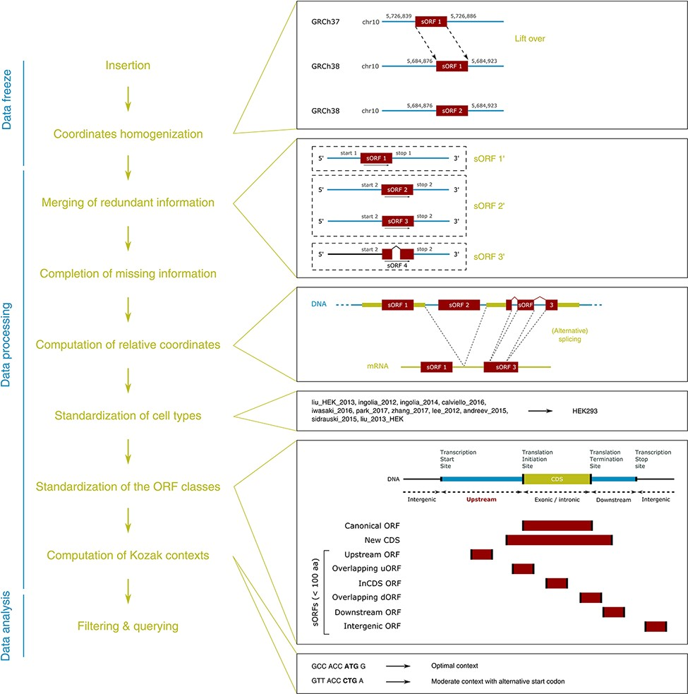
Figure 1. MetamORF pipeline. This figure represents the workflow used to build MetamORF. First, the data from the ...
Notes:
Figure 1. MetamORF pipeline. This figure represents the workflow used to build MetamORF. First, the data from the sources selected have been inserted into the database, and the absolute genomic coordinates have been homogenized from their original annotation version to the most recent version (GRCh38 or GRCm38). Then, the redundant information, i.e. the entries describing the same ORFs (same start, stop and splicing), has been merged, allowing to get one single and unique entries for each ORF detected on the human and mouse genomes. The missing information (sequences and transcript biotypes) has been downloaded from Ensembl, and the ORF relative coordinates have been computed. Finally, the cell types and ORF classes have been normalized, and the Kozak contexts have been computed using the sequences flanking the start codons.
Unless provided in the caption above, the following copyright applies to the content of this slide: © The Author(s) 2021. Published by Oxford University Press.This is an Open Access article distributed under the terms of the Creative Commons Attribution License (http://creativecommons.org/licenses/by/4.0/), which permits unrestricted reuse, distribution, and reproduction in any medium, provided the original work is properly cited.

Slide 2
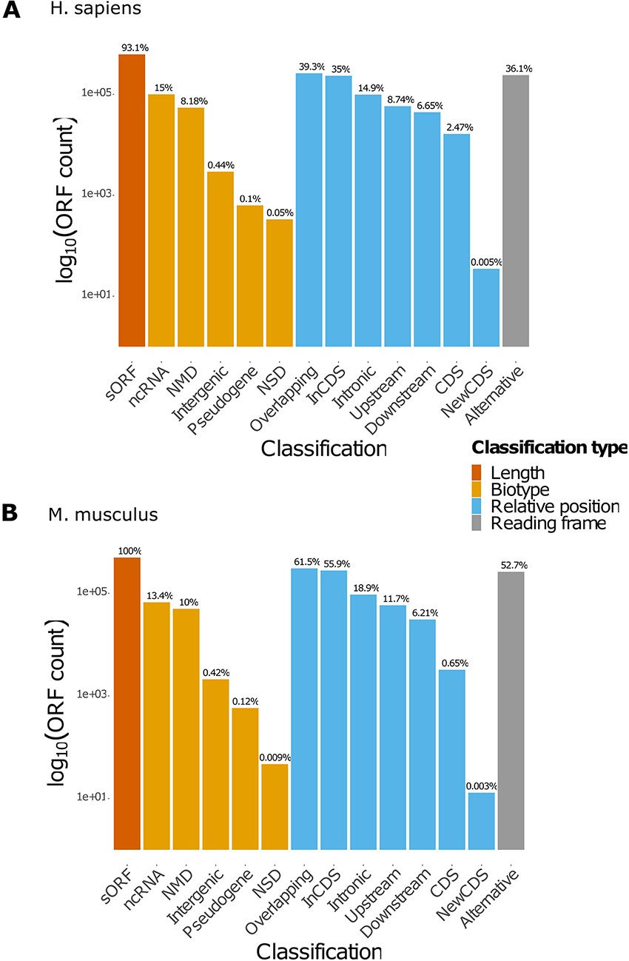
Figure 2. Count of ORFs in each class. The bar plots represent the count of ORFs annotated for each class for (A) H. ...
Notes:
Figure 2. Count of ORFs in each class. The bar plots represent the count of ORFs annotated for each class for (A) H. sapiens and (B) M. musculus. The percentages displayed over the bars indicate the proportion of ORFs annotated in the class over the total number of ORFs registered in the database for the species. NMD: non-sense-mediated decay; NSD: non-stop decay.
Unless provided in the caption above, the following copyright applies to the content of this slide: © The Author(s) 2021. Published by Oxford University Press.This is an Open Access article distributed under the terms of the Creative Commons Attribution License (http://creativecommons.org/licenses/by/4.0/), which permits unrestricted reuse, distribution, and reproduction in any medium, provided the original work is properly cited.

Slide 3
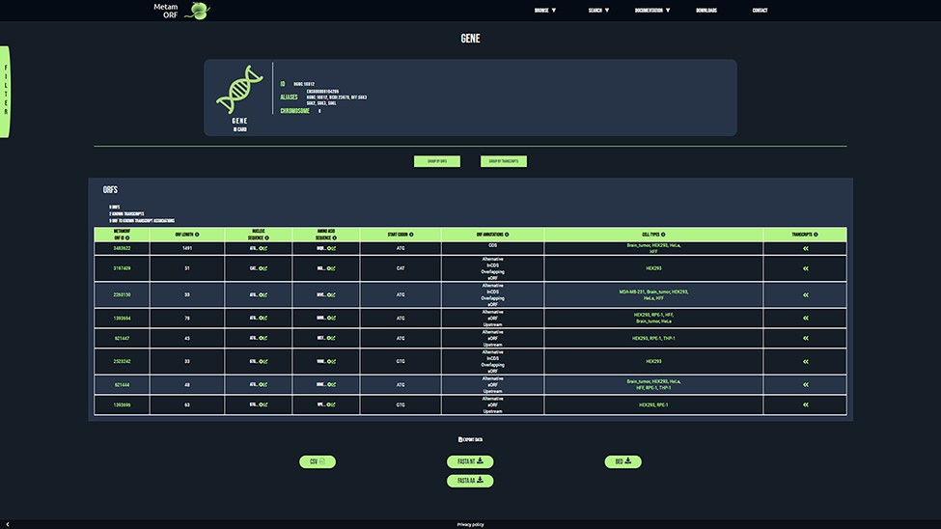
Figure 3. MetamORF gene-centric view. The page displays the transcripts and the ORFs related to SGK3 gene. A filter has ...
Notes:
Figure 3. MetamORF gene-centric view. The page displays the transcripts and the ORFs related to SGK3 gene. A filter has been applied to select exclusively the ORFs detected in HFF, Jurkat, RPE-1, HEK293 or HeLa cells. Other filters may be used and the results can be exported as CSV, FASTA or BED files.
Unless provided in the caption above, the following copyright applies to the content of this slide: © The Author(s) 2021. Published by Oxford University Press.This is an Open Access article distributed under the terms of the Creative Commons Attribution License (http://creativecommons.org/licenses/by/4.0/), which permits unrestricted reuse, distribution, and reproduction in any medium, provided the original work is properly cited.

