Slide 1
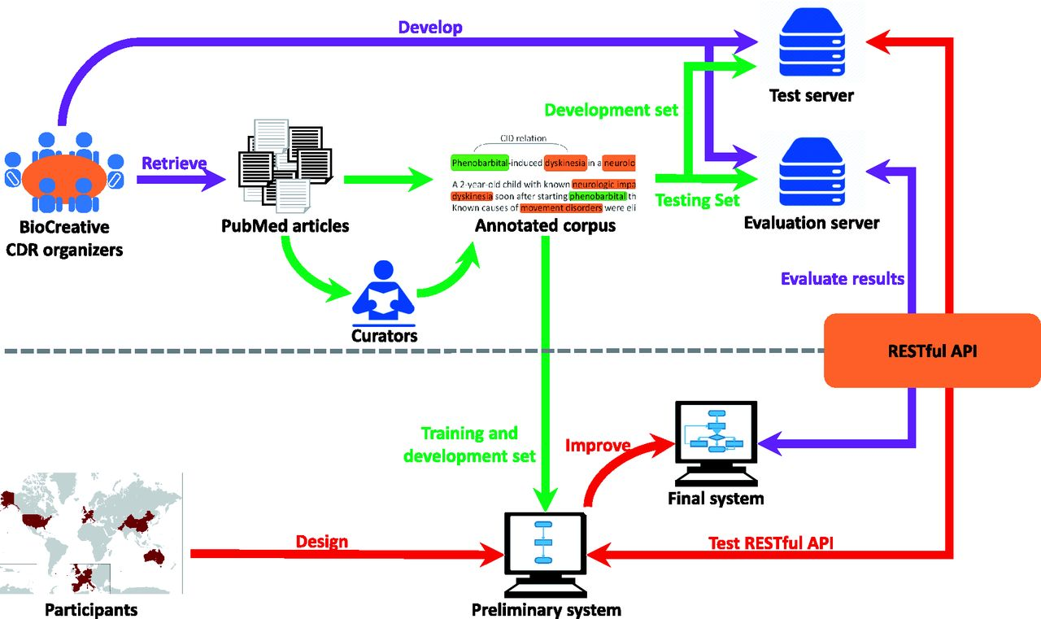
Figure 1. The pipeline of the task workflow. The task organization is shown in purple; corpus development is shown in ...
Notes:
Figure 1. The pipeline of the task workflow. The task organization is shown in purple; corpus development is shown in green; and team participation is shown in red.
Unless provided in the caption above, the following copyright applies to the content of this slide: Published by Oxford University Press 2016. This work is written by US Government employees and is in the public domain in the US.

Slide 2
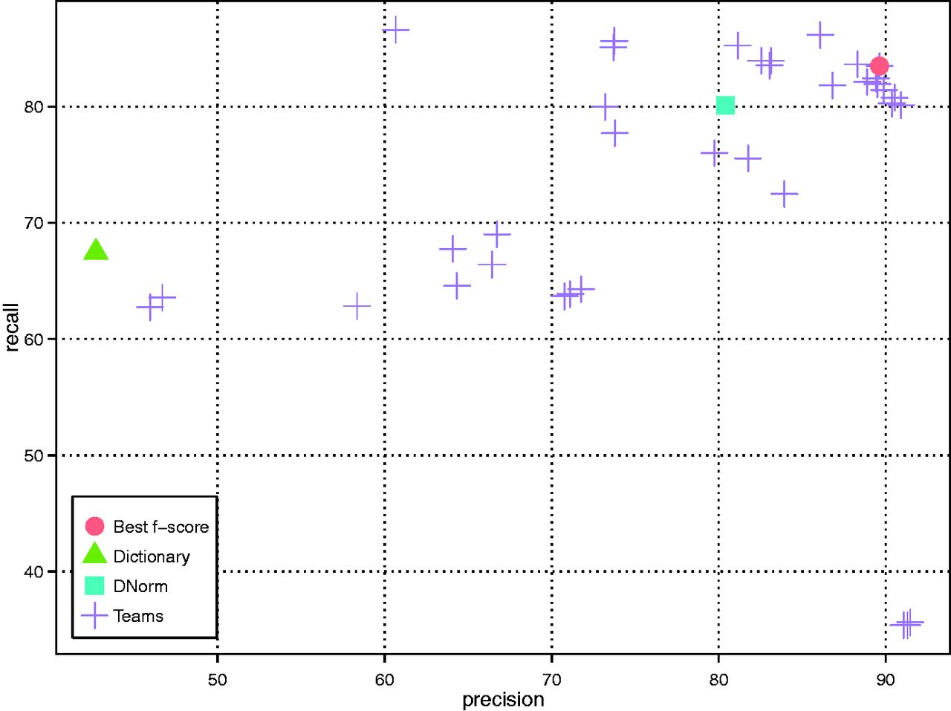
Figure 2. DNER results of all teams as well as the baseline (dictionary look up) and DNorm systems.
Notes:
Figure 2. DNER results of all teams as well as the baseline (dictionary look up) and DNorm systems.
Unless provided in the caption above, the following copyright applies to the content of this slide: Published by Oxford University Press 2016. This work is written by US Government employees and is in the public domain in the US.

Slide 3
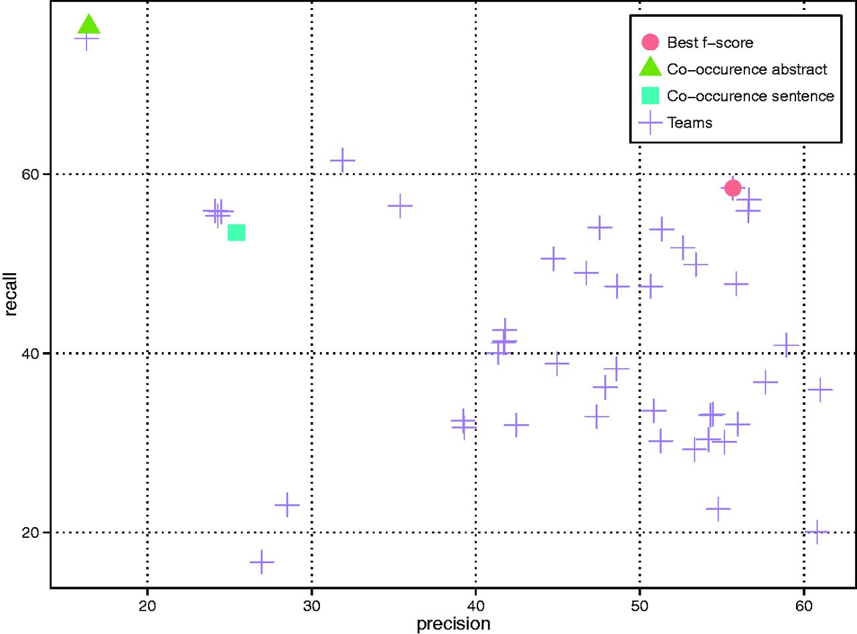
Figure 3. CID results of all teams as well as two variants of the co-occurrence baseline method (i.e. abstract- and ...
Notes:
Figure 3. CID results of all teams as well as two variants of the co-occurrence baseline method (i.e. abstract- and sentence-level).
Unless provided in the caption above, the following copyright applies to the content of this slide: Published by Oxford University Press 2016. This work is written by US Government employees and is in the public domain in the US.

Slide 4
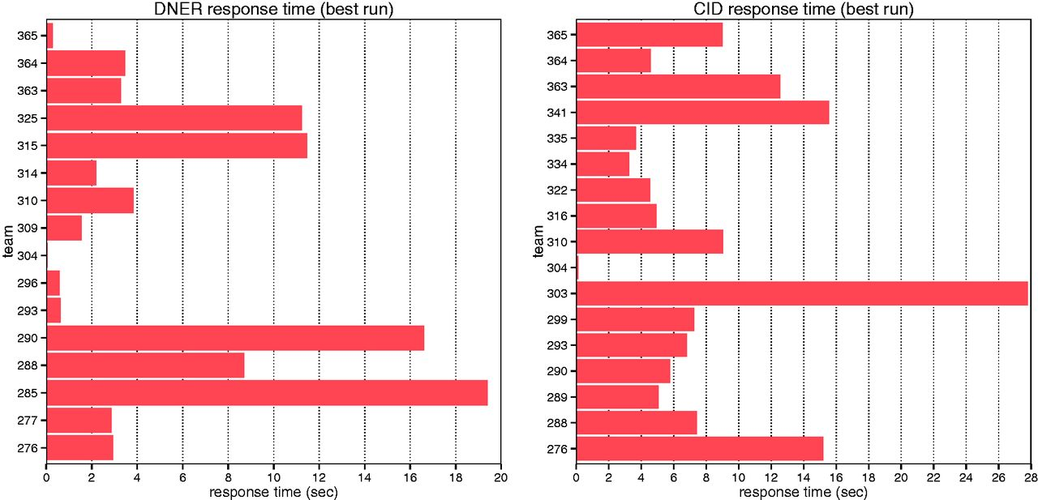
Figure 4. Average response time of each individual team for DNER and CID tasks.
Notes:
Figure 4. Average response time of each individual team for DNER and CID tasks.
Unless provided in the caption above, the following copyright applies to the content of this slide: Published by Oxford University Press 2016. This work is written by US Government employees and is in the public domain in the US.

