Slide 1
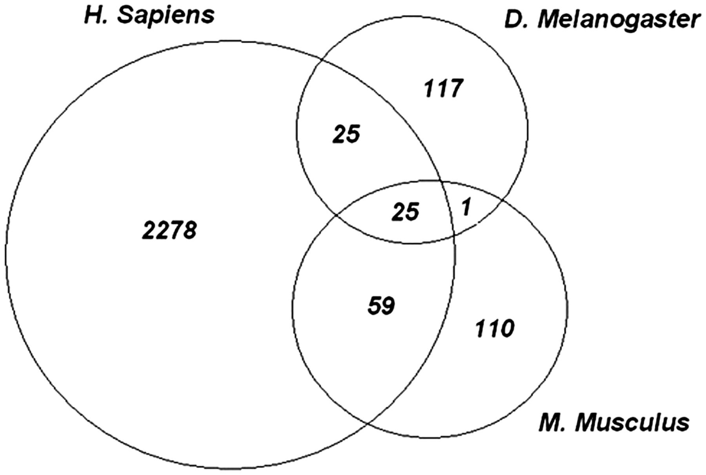
Figure 2. Evolutionarily conserved phosphosites. Each of the experimental phosphopeptide data sets were mapped onto ...
Notes:
Figure 2. Evolutionarily conserved phosphosites. Each of the experimental phosphopeptide data sets were mapped onto conserved domain-specific hits and the site positions on the domain models were examined for overlap. The Venn diagram shows the number of sites that overlap between each species and among all three species. Twenty five highly conserved phosphorylation sites are shared by all species.
Unless provided in the caption above, the following copyright applies to the content of this slide: Published by Oxford University Press 2011.This is Open Access article distributed under the terms of the Creative Commons Attribution Non-Commercial License (http://creativecommons.org/licenses/by-nc/2.5), which permits unrestricted non-commercial use, distribution, and reproduction in any medium, provided the original work is properly cited.

