Slide 1
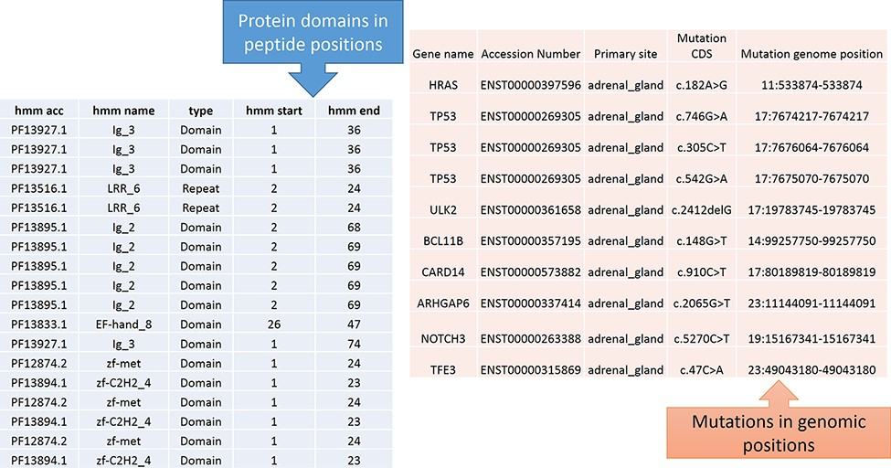
Figure 4. Predicted protein domains with peptide start and end (blue table) and cancer mutations are represented in ...
Notes:
Figure 4. Predicted protein domains with peptide start and end (blue table) and cancer mutations are represented in genomic positions for the adrenal gland (pink table).
Unless provided in the caption above, the following copyright applies to the content of this slide: © The Author(s) 2021. Published by Oxford University Press.This is an Open Access article distributed under the terms of the Creative Commons Attribution License (https://creativecommons.org/licenses/by/4.0/), which permits unrestricted reuse, distribution, and reproduction in any medium, provided the original work is properly cited.

Slide 2
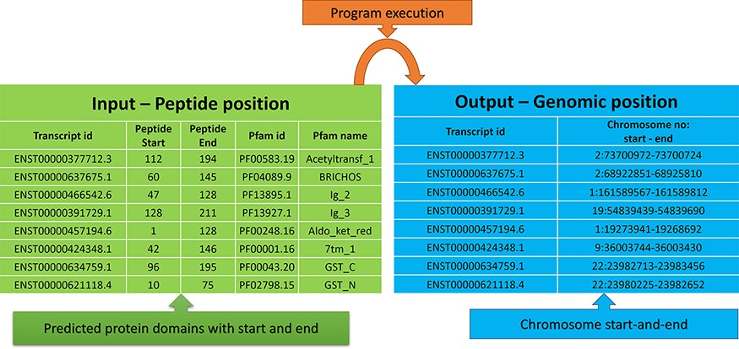
Figure 5. Input and output features for the peptide to genome program execution. The green table indicates the peptide ...
Notes:
Figure 5. Input and output features for the peptide to genome program execution. The green table indicates the peptide positions for each transcript id, and the program’s output provides the genomic locations as depicted in the blue table.
Unless provided in the caption above, the following copyright applies to the content of this slide: © The Author(s) 2021. Published by Oxford University Press.This is an Open Access article distributed under the terms of the Creative Commons Attribution License (https://creativecommons.org/licenses/by/4.0/), which permits unrestricted reuse, distribution, and reproduction in any medium, provided the original work is properly cited.

Slide 3
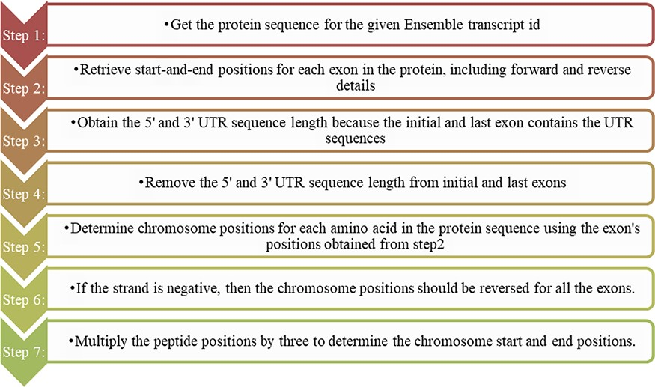
Figure 1. Steps for converting protein domain position to genome position.
Notes:
Figure 1. Steps for converting protein domain position to genome position.
Unless provided in the caption above, the following copyright applies to the content of this slide: © The Author(s) 2021. Published by Oxford University Press.This is an Open Access article distributed under the terms of the Creative Commons Attribution License (https://creativecommons.org/licenses/by/4.0/), which permits unrestricted reuse, distribution, and reproduction in any medium, provided the original work is properly cited.

Slide 4
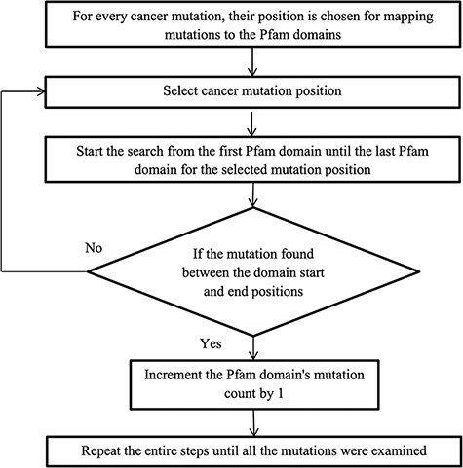
Figure 2. Flowchart for mapping mutations to the protein domains.
Notes:
Figure 2. Flowchart for mapping mutations to the protein domains.
Unless provided in the caption above, the following copyright applies to the content of this slide: © The Author(s) 2021. Published by Oxford University Press.This is an Open Access article distributed under the terms of the Creative Commons Attribution License (https://creativecommons.org/licenses/by/4.0/), which permits unrestricted reuse, distribution, and reproduction in any medium, provided the original work is properly cited.

Slide 5
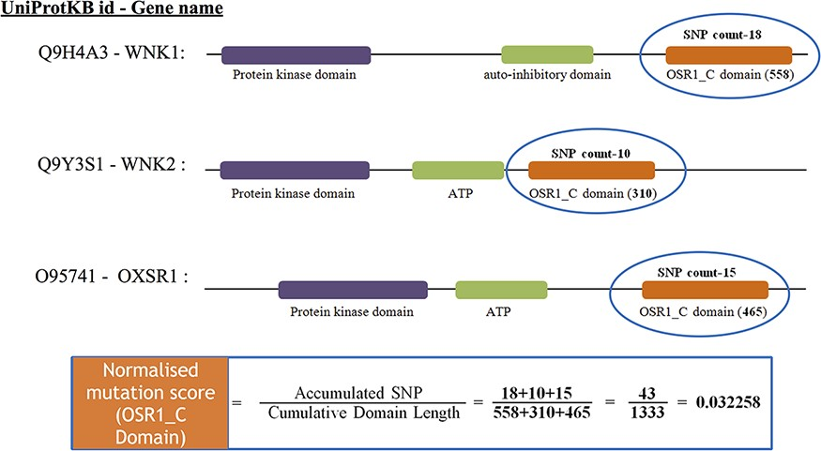
Figure 3. The estimate of normalized mutation count for the OSR1_C domain.
Notes:
Figure 3. The estimate of normalized mutation count for the OSR1_C domain.
Unless provided in the caption above, the following copyright applies to the content of this slide: © The Author(s) 2021. Published by Oxford University Press.This is an Open Access article distributed under the terms of the Creative Commons Attribution License (https://creativecommons.org/licenses/by/4.0/), which permits unrestricted reuse, distribution, and reproduction in any medium, provided the original work is properly cited.

Slide 6
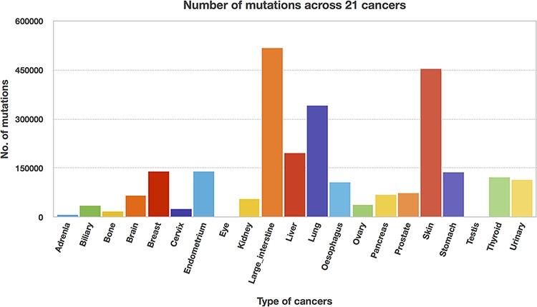
Figure 8. Mutation counts across 21 cancer types.
Notes:
Figure 8. Mutation counts across 21 cancer types.
Unless provided in the caption above, the following copyright applies to the content of this slide: © The Author(s) 2021. Published by Oxford University Press.This is an Open Access article distributed under the terms of the Creative Commons Attribution License (https://creativecommons.org/licenses/by/4.0/), which permits unrestricted reuse, distribution, and reproduction in any medium, provided the original work is properly cited.

Slide 7
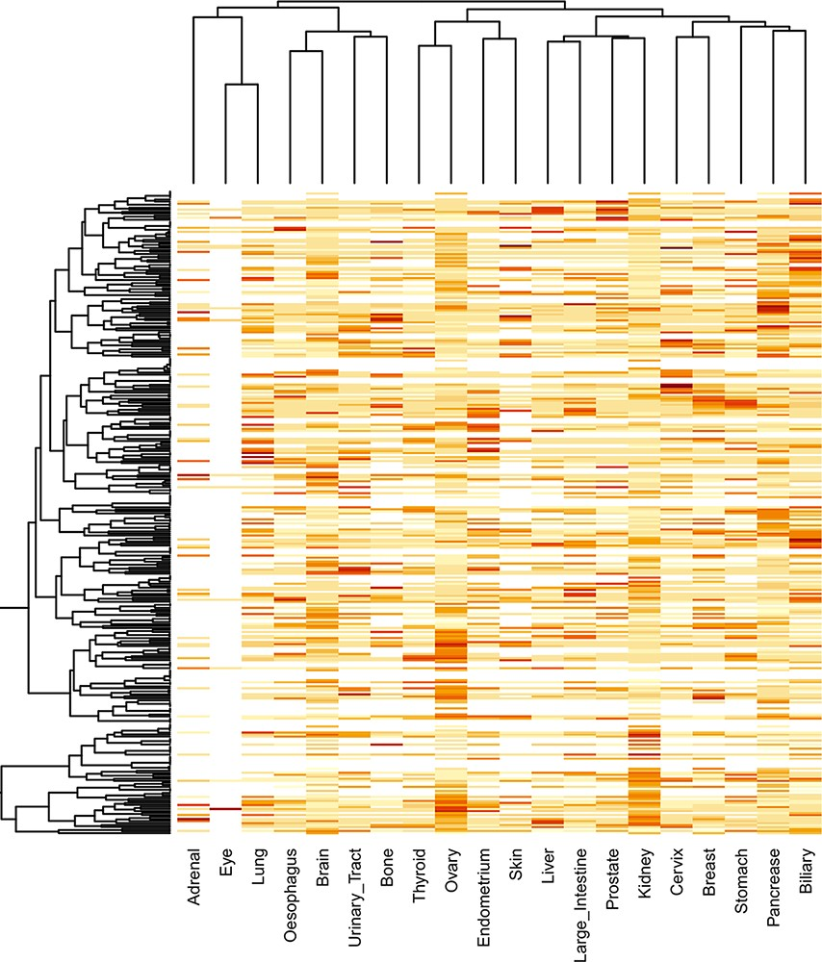
Figure 9. Clustering of significantly mutated domains (SMDs) across different cancer types. The heatmap reveals the ...
Notes:
Figure 9. Clustering of significantly mutated domains (SMDs) across different cancer types. The heatmap reveals the importance of cancer-specific SMDs in various cancers. The sidebars in the same color represent the domain instances belonging to the specific cancer type.
Unless provided in the caption above, the following copyright applies to the content of this slide: © The Author(s) 2021. Published by Oxford University Press.This is an Open Access article distributed under the terms of the Creative Commons Attribution License (https://creativecommons.org/licenses/by/4.0/), which permits unrestricted reuse, distribution, and reproduction in any medium, provided the original work is properly cited.

Slide 8
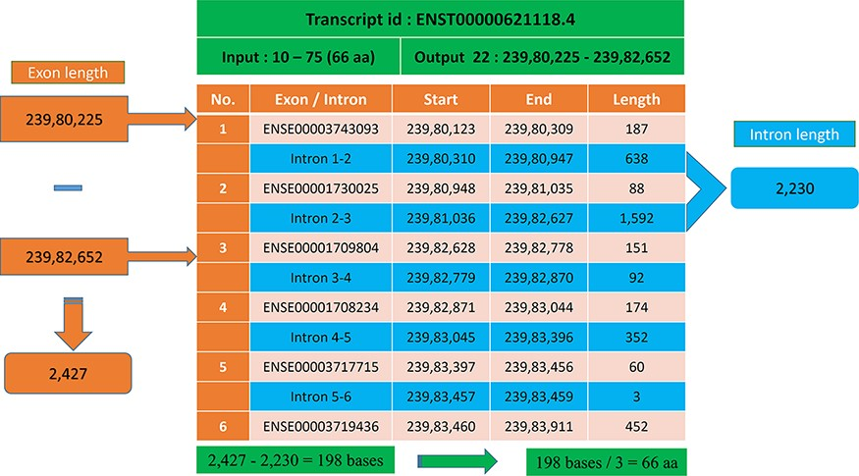
Figure 6. Transcript with multiple exons and introns. The Pfam domain GST_N length is 66aa, where the actual bases are ...
Notes:
Figure 6. Transcript with multiple exons and introns. The Pfam domain GST_N length is 66aa, where the actual bases are obtained by subtracting the intron length (blue) from the genomic positions (orange).
Unless provided in the caption above, the following copyright applies to the content of this slide: © The Author(s) 2021. Published by Oxford University Press.This is an Open Access article distributed under the terms of the Creative Commons Attribution License (https://creativecommons.org/licenses/by/4.0/), which permits unrestricted reuse, distribution, and reproduction in any medium, provided the original work is properly cited.

Slide 9
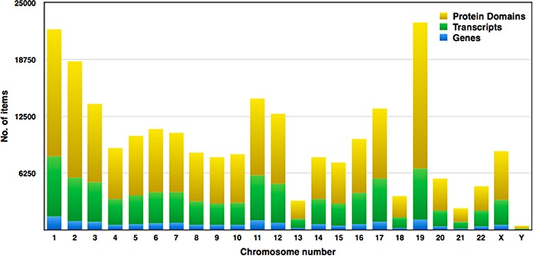
Figure 7. Distribution of genes, transcripts and protein domains within human chromosomes.
Notes:
Figure 7. Distribution of genes, transcripts and protein domains within human chromosomes.
Unless provided in the caption above, the following copyright applies to the content of this slide: © The Author(s) 2021. Published by Oxford University Press.This is an Open Access article distributed under the terms of the Creative Commons Attribution License (https://creativecommons.org/licenses/by/4.0/), which permits unrestricted reuse, distribution, and reproduction in any medium, provided the original work is properly cited.

