Slide 1
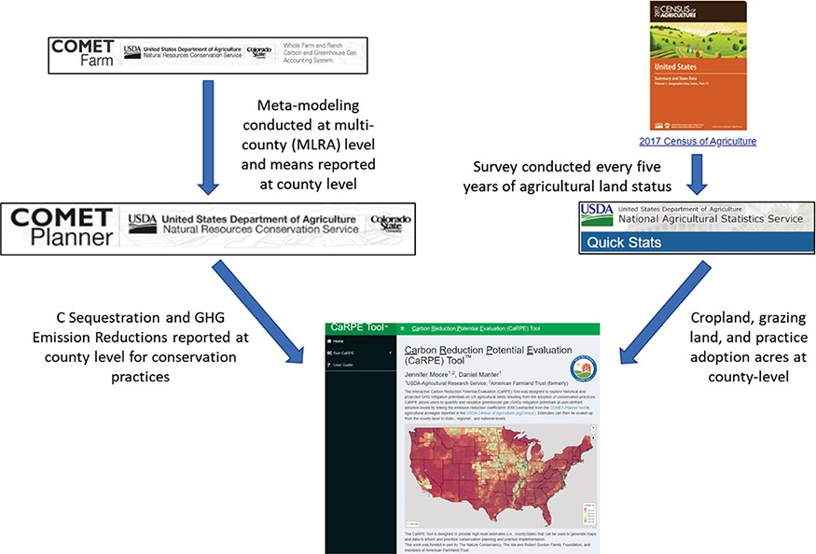
Figure 1. A graphical overview of the input databases used in the CaRPE tool.
Notes:
Figure 1. A graphical overview of the input databases used in the CaRPE tool.
Unless provided in the caption above, the following copyright applies to the content of this slide: Published by Oxford University Press 2022. This work is written by (a) US Government employee(s) and is in the public domain in the US.This work is written by (a) US Government employee(s) and is in the public domain in the US.

Slide 2
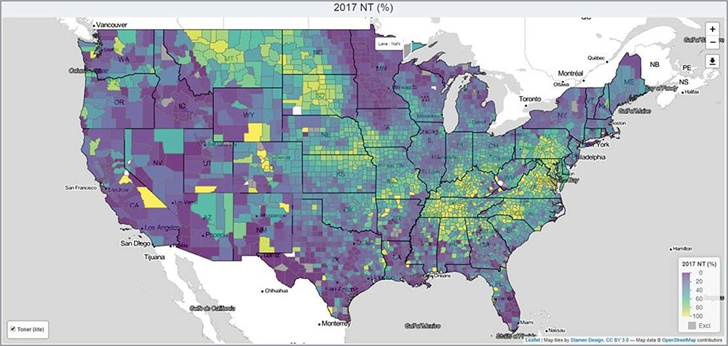
Figure 2. 2017 no-till adoption (%) as reported in CaRPE.
Notes:
Figure 2. 2017 no-till adoption (%) as reported in CaRPE.
Unless provided in the caption above, the following copyright applies to the content of this slide: Published by Oxford University Press 2022. This work is written by (a) US Government employee(s) and is in the public domain in the US.This work is written by (a) US Government employee(s) and is in the public domain in the US.

Slide 3
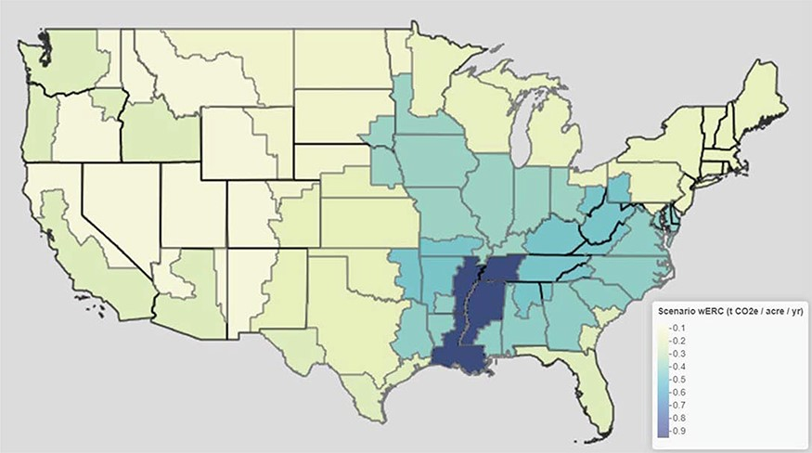
Figure 3. Cover crop wERCs with default scenario options.
Notes:
Figure 3. Cover crop wERCs with default scenario options.
Unless provided in the caption above, the following copyright applies to the content of this slide: Published by Oxford University Press 2022. This work is written by (a) US Government employee(s) and is in the public domain in the US.This work is written by (a) US Government employee(s) and is in the public domain in the US.

Slide 4
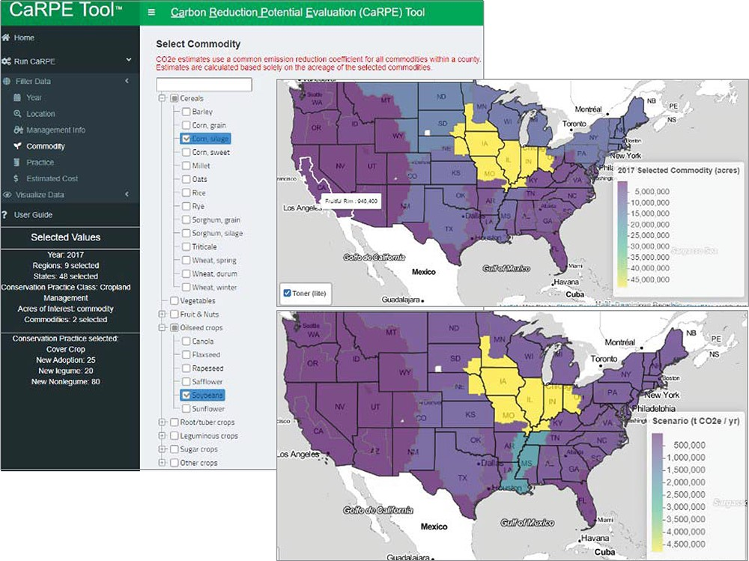
Figure 4. CaRPE screenshot showing an example of limiting acres to grain corn and soybeans, a map pooled by region ...
Notes:
Figure 4. CaRPE screenshot showing an example of limiting acres to grain corn and soybeans, a map pooled by region showing the distribution of those acres across the nine FSRs and the distribution of the tonnes of CO2e reduction potentials resulting from a cover crop scenario using the default settings.
Unless provided in the caption above, the following copyright applies to the content of this slide: Published by Oxford University Press 2022. This work is written by (a) US Government employee(s) and is in the public domain in the US.This work is written by (a) US Government employee(s) and is in the public domain in the US.

Slide 5
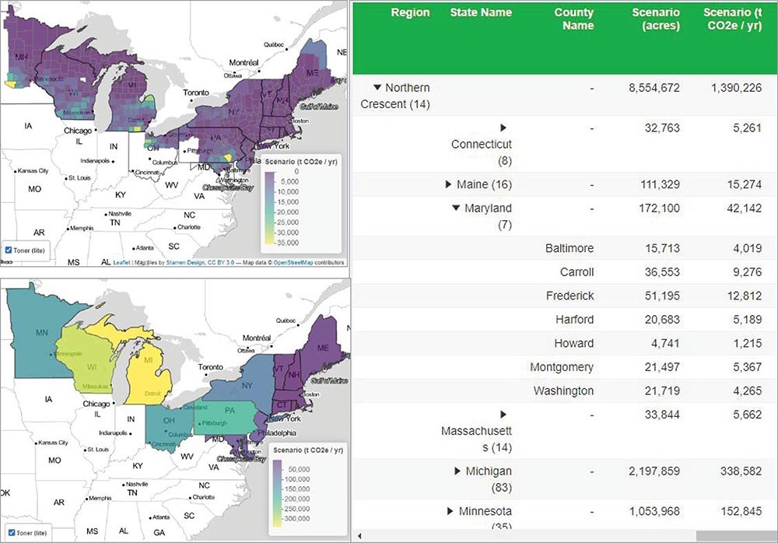
Figure 5. Map of the Northern Crescent region viewed at county and state pooling levels with tabular data reported at ...
Notes:
Figure 5. Map of the Northern Crescent region viewed at county and state pooling levels with tabular data reported at the county level. Scenario settings included adoption of 25% available cropland adopting a cover crop (20% legume and 80% non-legume) and assumed that 2017 acres in cover crop were composed of 10% legume and 90% non-legume.
Unless provided in the caption above, the following copyright applies to the content of this slide: Published by Oxford University Press 2022. This work is written by (a) US Government employee(s) and is in the public domain in the US.This work is written by (a) US Government employee(s) and is in the public domain in the US.

Slide 6
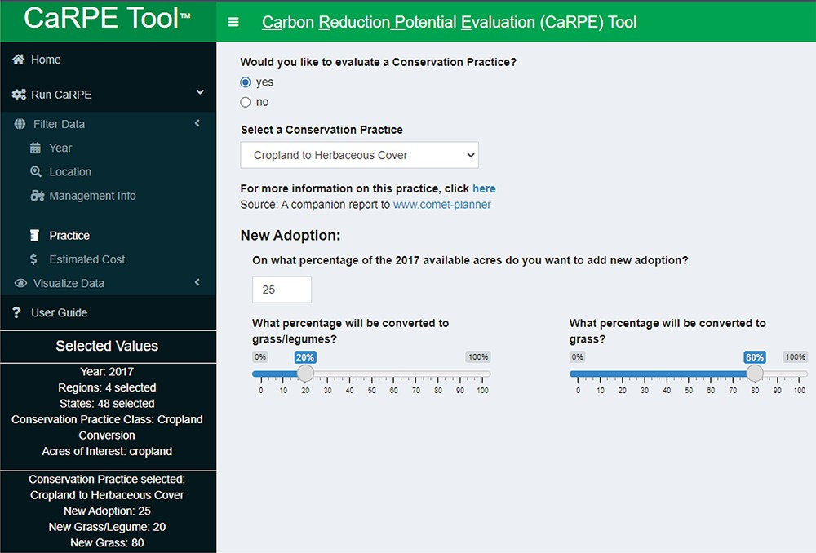
Figure 6. Example of the cropland to herbaceous cover practice illustrating user-defined variables for percent new ...
Notes:
Figure 6. Example of the cropland to herbaceous cover practice illustrating user-defined variables for percent new adoption and what percent will be converted to grass/legume or grass. Because conversion options remove cropland or grazing land from production, it is recommended to not exceed 25% new adoption without adequate justification.
Unless provided in the caption above, the following copyright applies to the content of this slide: Published by Oxford University Press 2022. This work is written by (a) US Government employee(s) and is in the public domain in the US.This work is written by (a) US Government employee(s) and is in the public domain in the US.

