Slide 1
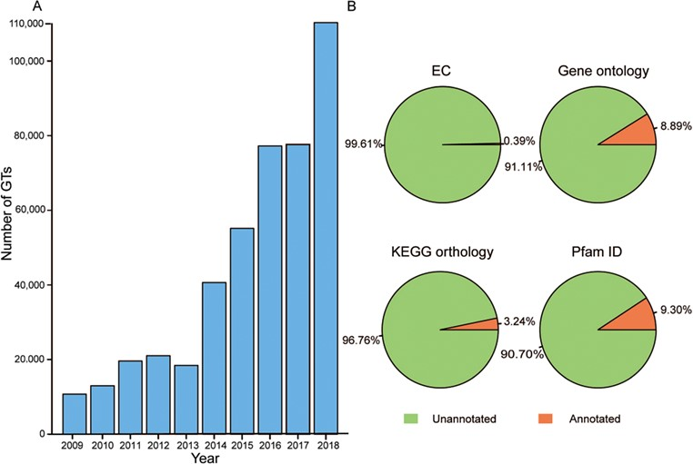
Figure 1 Growth of GT number over the past decade and the proportion of annotation data before predictions. (A) Number ...
Notes:
Figure 1 Growth of GT number over the past decade and the proportion of annotation data before predictions. (A) Number of GTs has increased rapidly in the past 10 years. (B) Orange represents GTs with the corresponding annotated data and green is GTs without the corresponding annotated data.
Unless provided in the caption above, the following copyright applies to the content of this slide: © The Author(s) 2020. Published by Oxford University Press.This is an Open Access article distributed under the terms of the Creative Commons Attribution License (http://creativecommons.org/licenses/by/4.0/), which permits unrestricted reuse, distribution, and reproduction in any medium, provided the original work is properly cited.

