Slide 1
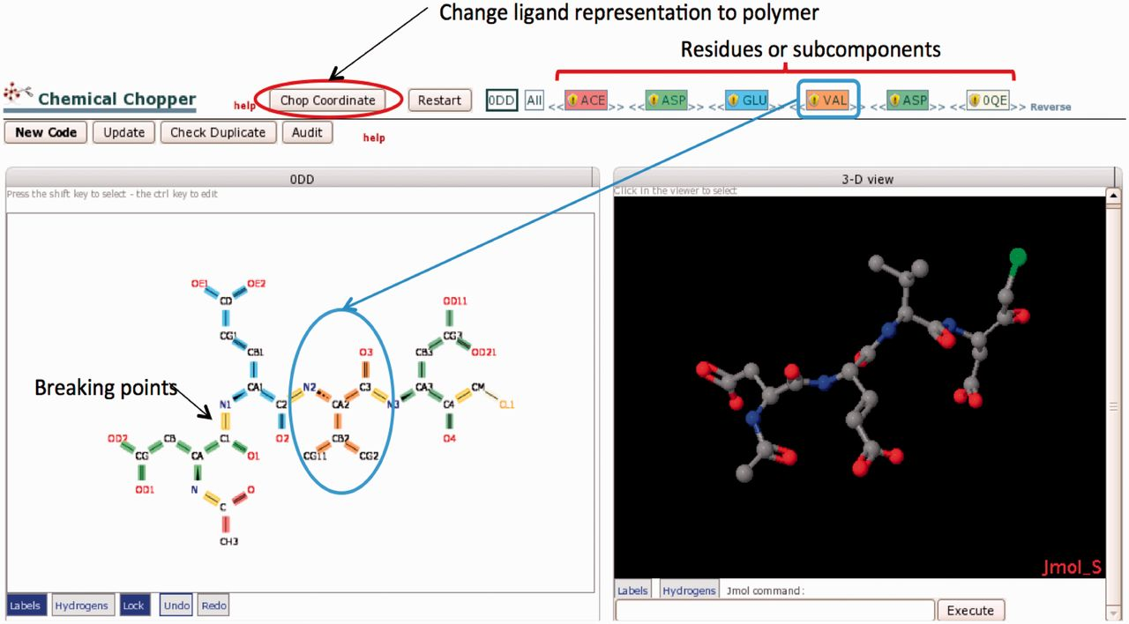
Figure 5. The Chopper Tool is used to break peptide-like inhibitors and antibiotics into individual polymeric residues ...
Notes:
Figure 5. The Chopper Tool is used to break peptide-like inhibitors and antibiotics into individual polymeric residues or subcomponents following BIRD definitions (Step 2.4 in Figure 1). Edits are made in the 2D view (lower left); selected bonds (highlighted in yellow) can be marked to be ‘chopped’. The chopped residue or subcomponent is then searched against the CCD; results are color-coded and listed in the top bar. For example, VAL is colored coded in orange. The order of residues/subcomponents listed at the top of the page can be changed (by dragging the name) as needed to provide the appropriate sequence. The 3D view (right) displays the same components shown in the 2D view. When the subcomponents have been created and the sequence is in the correct order, the ‘Chop Coordinates’ button will change the molecule to a polymeric representation in the PDB entry according to the selected decomposition.
Unless provided in the caption above, the following copyright applies to the content of this slide: © The Author(s) 2013. Published by Oxford University Press.This is an Open Access article distributed under the terms of the Creative Commons Attribution License (http://creativecommons.org/licenses/by/3.0/), which permits unrestricted reuse, distribution, and reproduction in any medium, provided the original work is properly cited.

