Slide 1
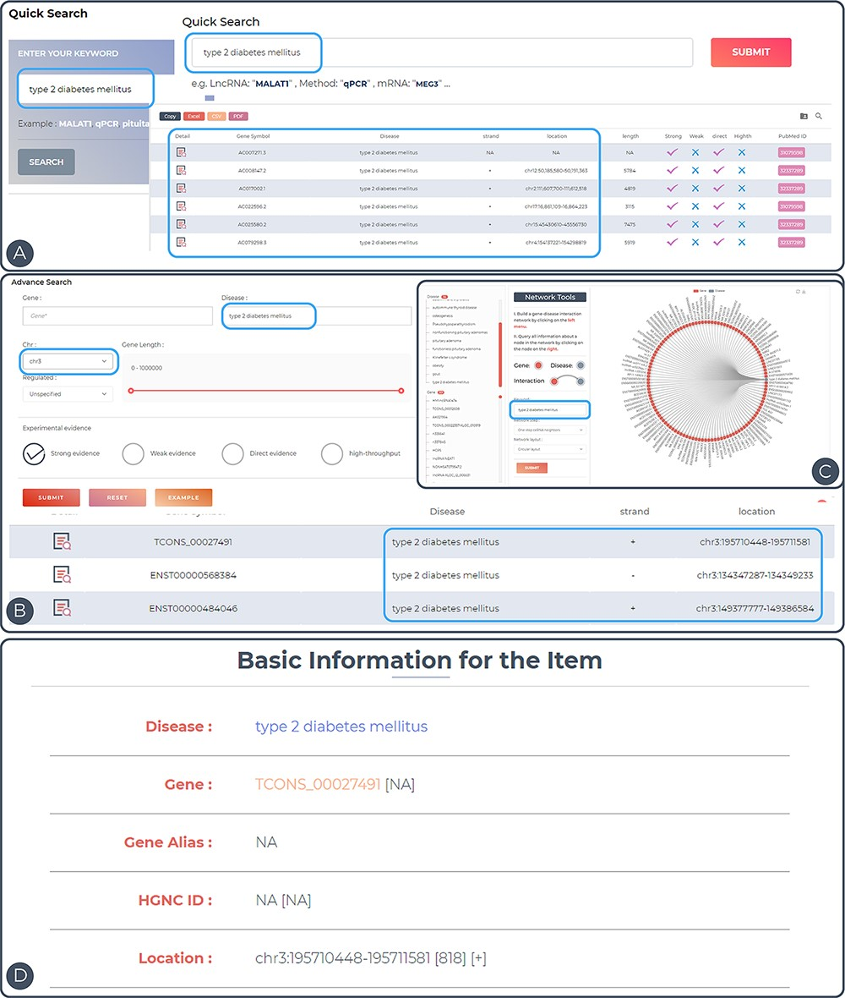
Figure 3. Features and utilities of ENCD. (A) A single keyword search and the corresponding results presentation using ...
Notes:
Figure 3. Features and utilities of ENCD. (A) A single keyword search and the corresponding results presentation using a quick query. (B) A multi-criteria search and display of results using an advanced query. (C) Browsing the web based on keywords in the interface. (D) Detailed display of query entries.
Unless provided in the caption above, the following copyright applies to the content of this slide: © The Author(s) 2023. Published by Oxford University Press.This is an Open Access article distributed under the terms of the Creative Commons Attribution License (https://creativecommons.org/licenses/by/4.0/), which permits unrestricted reuse, distribution, and reproduction in any medium, provided the original work is properly cited.

