Slide 1
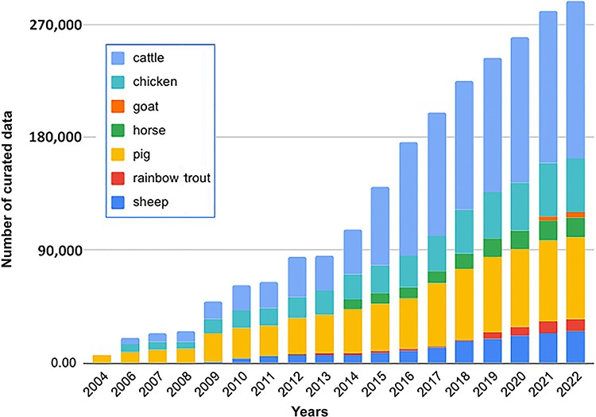
Figure 1. An increase in curated QTL/association/correlation/heritability data in the Animal QTLdb and CorrDB over the ...
Notes:
Figure 1. An increase in curated QTL/association/correlation/heritability data in the Animal QTLdb and CorrDB over the past 18 years. The data are plotted using log-transformed values for better visualization.
Unless provided in the caption above, the following copyright applies to the content of this slide: © The Author(s) 2023. Published by Oxford University Press.This is an Open Access article distributed under the terms of the Creative Commons Attribution License (https://creativecommons.org/licenses/by/4.0/), which permits unrestricted reuse, distribution, and reproduction in any medium, provided the original work is properly cited.

Slide 2
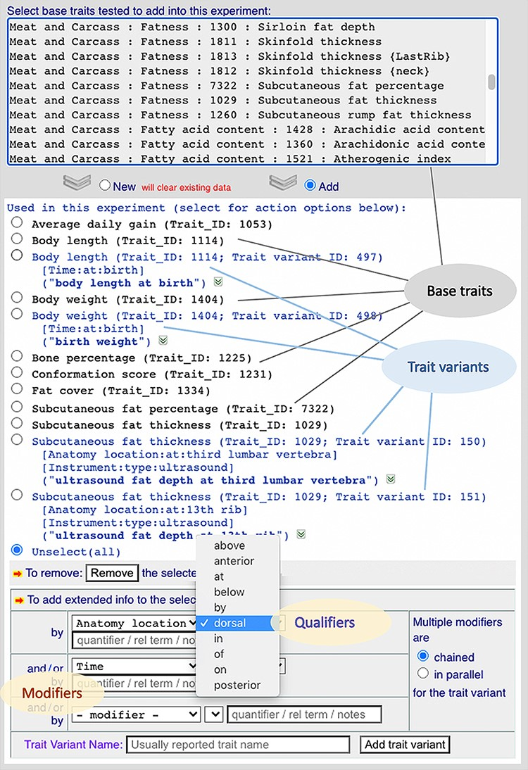
Figure 3. A screenshot of a curation web form showing part of the experiment curation environment. It shows how this ...
Notes:
Figure 3. A screenshot of a curation web form showing part of the experiment curation environment. It shows how this implementation allows trait variants to be created from their base traits using controlled vocabulary lists to define modifiers/qualifiers.
Unless provided in the caption above, the following copyright applies to the content of this slide: © The Author(s) 2023. Published by Oxford University Press.This is an Open Access article distributed under the terms of the Creative Commons Attribution License (https://creativecommons.org/licenses/by/4.0/), which permits unrestricted reuse, distribution, and reproduction in any medium, provided the original work is properly cited.

Slide 3
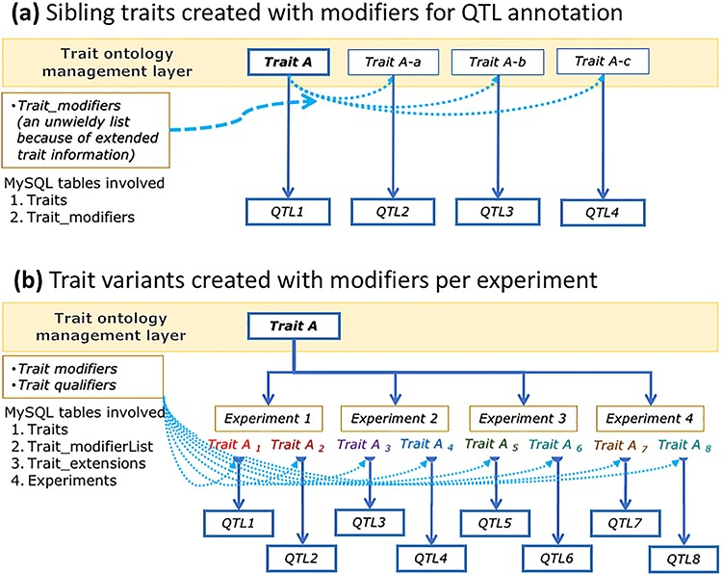
Figure 2. A conceptual graph showing data structure differences between ‘sibling traits’ (modified as part of ontology ...
Notes:
Figure 2. A conceptual graph showing data structure differences between ‘sibling traits’ (modified as part of ontology extensions) (a) and ‘trait variants’ (modified with extended info) created at the experiment level (b), their use in QTL data annotations and their effects on ontology trait data management.
Unless provided in the caption above, the following copyright applies to the content of this slide: © The Author(s) 2023. Published by Oxford University Press.This is an Open Access article distributed under the terms of the Creative Commons Attribution License (https://creativecommons.org/licenses/by/4.0/), which permits unrestricted reuse, distribution, and reproduction in any medium, provided the original work is properly cited.

