Slide 1
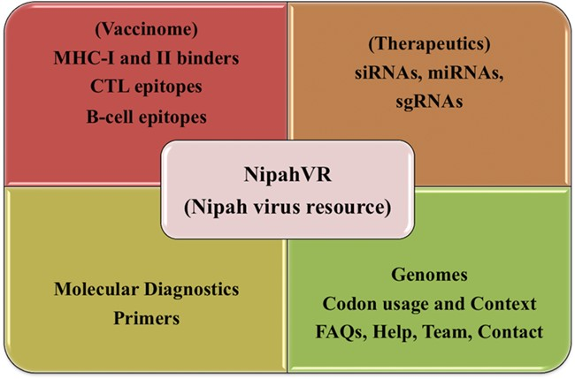
Figure 1 Overview of NipahVR resource components.
Notes:
Figure 1 Overview of NipahVR resource components.
Unless provided in the caption above, the following copyright applies to the content of this slide: © The Author(s) 2020. Published by Oxford University Press.This is an Open Access article distributed under the terms of the Creative Commons Attribution License (http://creativecommons.org/licenses/by/4.0/), which permits unrestricted reuse, distribution, and reproduction in any medium, provided the original work is properly cited.

Slide 2
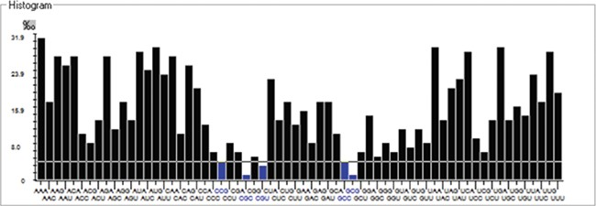
Figure 2 Histogram showing codon distribution (rare (blue) and preferred (black)) of NiV genome.
Notes:
Figure 2 Histogram showing codon distribution (rare (blue) and preferred (black)) of NiV genome.
Unless provided in the caption above, the following copyright applies to the content of this slide: © The Author(s) 2020. Published by Oxford University Press.This is an Open Access article distributed under the terms of the Creative Commons Attribution License (http://creativecommons.org/licenses/by/4.0/), which permits unrestricted reuse, distribution, and reproduction in any medium, provided the original work is properly cited.

Slide 3
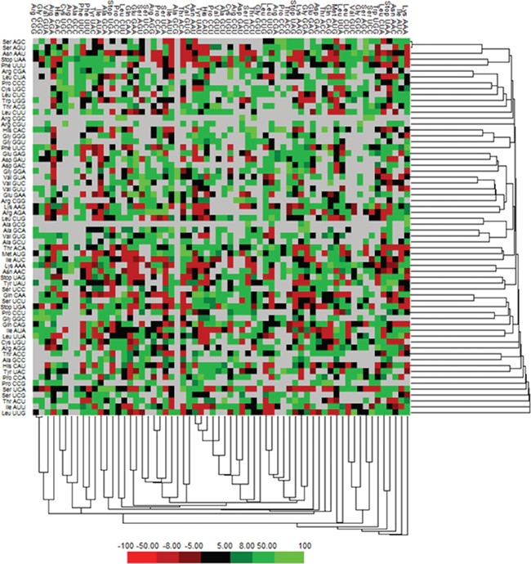
Figure 3 Matrix illustrating codon context analysis.
Notes:
Figure 3 Matrix illustrating codon context analysis.
Unless provided in the caption above, the following copyright applies to the content of this slide: © The Author(s) 2020. Published by Oxford University Press.This is an Open Access article distributed under the terms of the Creative Commons Attribution License (http://creativecommons.org/licenses/by/4.0/), which permits unrestricted reuse, distribution, and reproduction in any medium, provided the original work is properly cited.

Slide 4
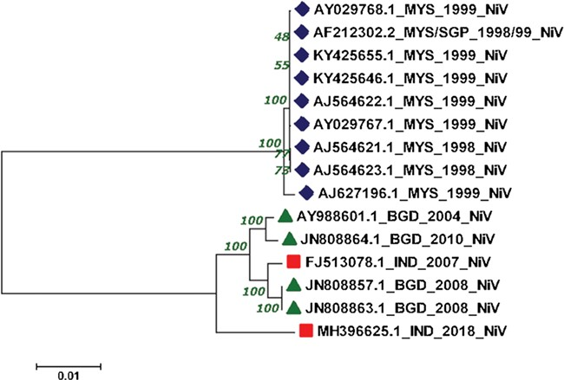
Figure 4 Phylogenetic tree showing the relationship of 15 NiV complete genomes employing Neighbor-joining method.
Notes:
Figure 4 Phylogenetic tree showing the relationship of 15 NiV complete genomes employing Neighbor-joining method.
Unless provided in the caption above, the following copyright applies to the content of this slide: © The Author(s) 2020. Published by Oxford University Press.This is an Open Access article distributed under the terms of the Creative Commons Attribution License (http://creativecommons.org/licenses/by/4.0/), which permits unrestricted reuse, distribution, and reproduction in any medium, provided the original work is properly cited.

Slide 5
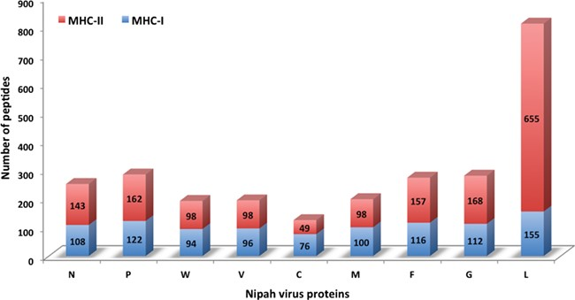
Figure 5 Chart displaying the number of MHC-I and -II binders from different proteins.
Notes:
Figure 5 Chart displaying the number of MHC-I and -II binders from different proteins.
Unless provided in the caption above, the following copyright applies to the content of this slide: © The Author(s) 2020. Published by Oxford University Press.This is an Open Access article distributed under the terms of the Creative Commons Attribution License (http://creativecommons.org/licenses/by/4.0/), which permits unrestricted reuse, distribution, and reproduction in any medium, provided the original work is properly cited.

Slide 6
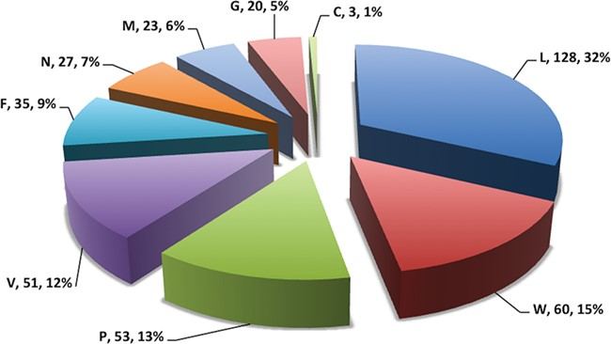
Figure 6 Pie chart showing number of putative b-cell epitopes for individual Nipah proteins.
Notes:
Figure 6 Pie chart showing number of putative b-cell epitopes for individual Nipah proteins.
Unless provided in the caption above, the following copyright applies to the content of this slide: © The Author(s) 2020. Published by Oxford University Press.This is an Open Access article distributed under the terms of the Creative Commons Attribution License (http://creativecommons.org/licenses/by/4.0/), which permits unrestricted reuse, distribution, and reproduction in any medium, provided the original work is properly cited.

Slide 7
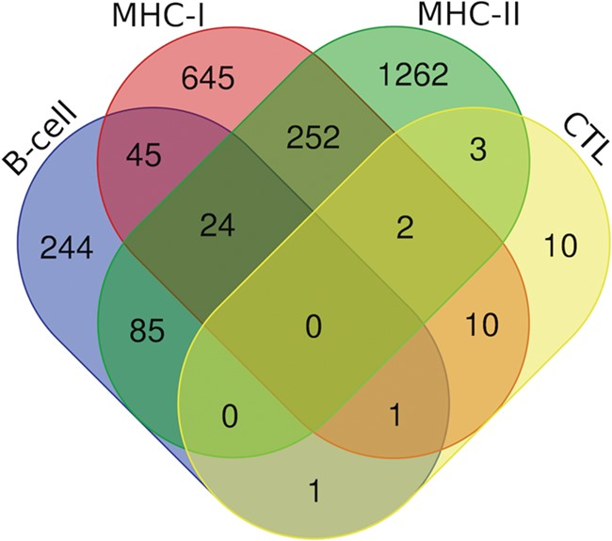
Figure 7 Venn diagram showing the number of peptides/epitopes belonging and common in diverse epitope classes.
Notes:
Figure 7 Venn diagram showing the number of peptides/epitopes belonging and common in diverse epitope classes.
Unless provided in the caption above, the following copyright applies to the content of this slide: © The Author(s) 2020. Published by Oxford University Press.This is an Open Access article distributed under the terms of the Creative Commons Attribution License (http://creativecommons.org/licenses/by/4.0/), which permits unrestricted reuse, distribution, and reproduction in any medium, provided the original work is properly cited.

