Slide 1
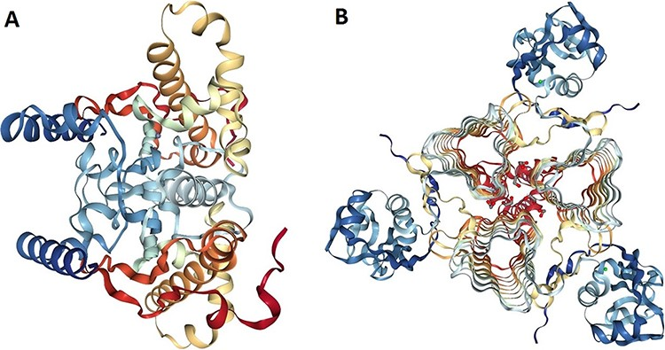
Figure 5. Protein structure analysis of β- and γ-CA protein sequences from bacterial contaminants. (A) Accession ID: ...
Notes:
Figure 5. Protein structure analysis of β- and γ-CA protein sequences from bacterial contaminants. (A) Accession ID: 5JJ8 crystal structure belongs to β-CA from P. aeruginosa, and (B) Accession ID: 3PMO crystal structure belongs to γ-CA from P. aeruginosa. A and B were obtained from the PDB database, which are the most similar crystalized structures to β- and γ-CAs from bacterial contaminants, respectively.
Unless provided in the caption above, the following copyright applies to the content of this slide: © The Author(s) 2021. Published by Oxford University Press.This is an Open Access article distributed under the terms of the Creative Commons Attribution License (http://creativecommons.org/licenses/by/4.0/), which permits unrestricted reuse, distribution, and reproduction in any medium, provided the original work is properly cited.

