Slide 1
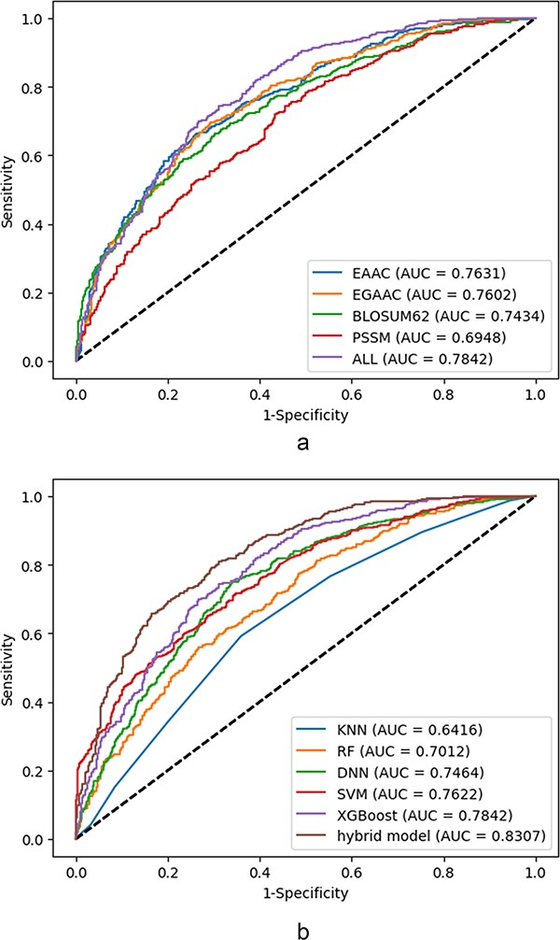
Figure 6. ROC curves corresponding to the individual feature and collective features: (a) ROCs corresponding to the ...
Notes:
Figure 6. ROC curves corresponding to the individual feature and collective features: (a) ROCs corresponding to the best utilized classifier (XGBoost) based on the single feature, (b) ROCs corresponding to the utilized classifiers at the presence of all features.
Unless provided in the caption above, the following copyright applies to the content of this slide: © The Author(s) 2024. Published by Oxford University Press.This is an Open Access article distributed under the terms of the Creative Commons Attribution License (https://creativecommons.org/licenses/by/4.0/), which permits unrestricted reuse, distribution, and reproduction in any medium, provided the original work is properly cited.

