Slide 1
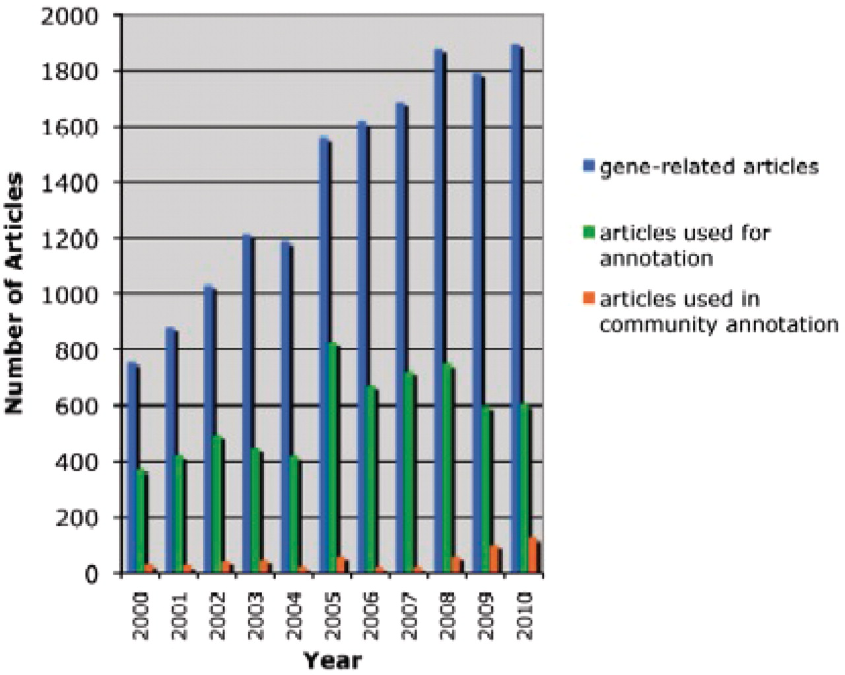
Figure 2. Literature-based annotation at TAIR (2000–2010). The total number of research articles containing Arabidopsis ...
Notes:
Figure 2. Literature-based annotation at TAIR (2000–2010). The total number of research articles containing Arabidopsis gene-related information in the TAIR database is represented in blue. In green and orange are the number of articles used for controlled vocabulary annotations by either TAIR or the community, respectively.
Unless provided in the caption above, the following copyright applies to the content of this slide: © The Author(s) 2012. Published by Oxford University Press.This is an Open Access article distributed under the terms of the Creative Commons Attribution Non-Commercial License (http://creativecommons.org/licenses/by-nc/3.0), which permits unrestricted non-commercial use, distribution, and reproduction in any medium, provided the original work is properly cited.

