Slide 1
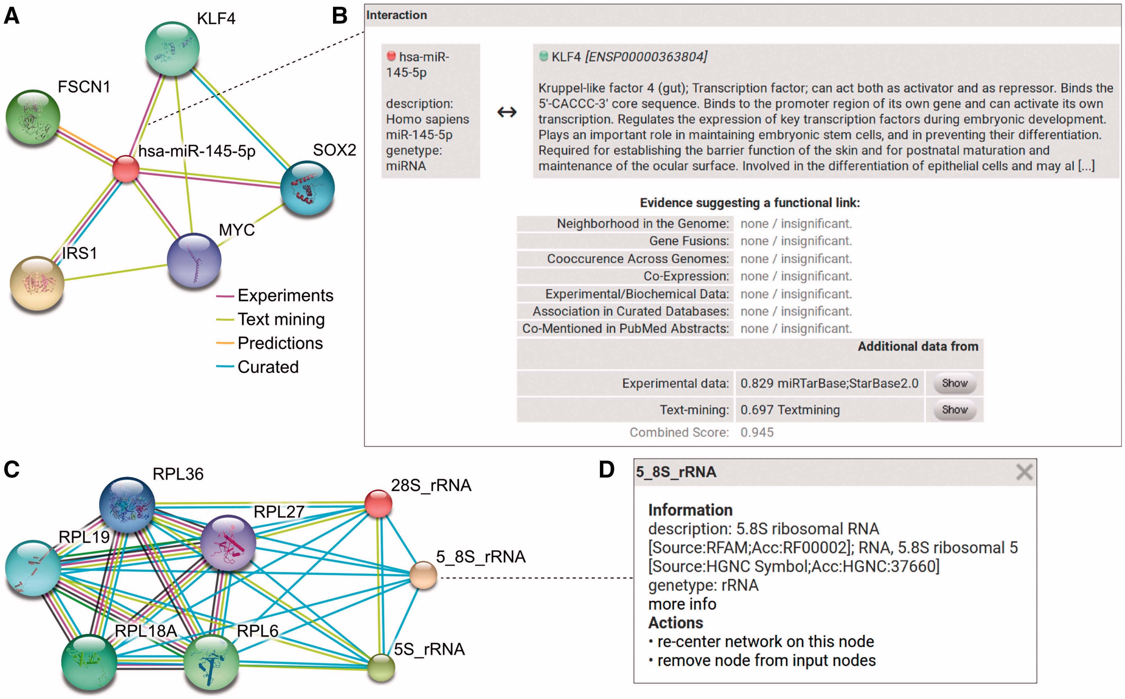
Figure 4 RAIN use case. (A) Querying RAIN for human miR-145-5p (miR-145), suggested to act as tumor-suppressor in ...
Notes:
Figure 4 RAIN use case. (A) Querying RAIN for human miR-145-5p (miR-145), suggested to act as tumor-suppressor in breast and colon cancer (40, 41), finds multiple oncogenes such as KLF4 and SOX2 (42, 43) as putative targets of miR-145. Evidence channels supporting each interaction are encoded as edge colors. (B) Sources of evidence for each association, e.g. between miR-145 and KLF4, are presented in a pop-up opened after clicking an edge in the network. RAIN confidence scores are collected in the ‘Additional data’ table. Information about KLF4 is provided by STRING. Clicking the ‘Show’ button leads to a website that links to research articles presenting experimental evidence and displaying detailed text mining evidence, where available. (C) In contrast to single identifier search (A), the RAIN multiple identifier search can be used to specifically view interactions between three ribosomal RNAs (28S_rRNA, 5_8S_rRNA, 5S_rRNA) and a subset of five ribosomal proteins part of the large ribosomal subunit. These interactions were extracted from Reactome (10) or found by text mining. (D) Clicking an ncRNA node in the network opens a popup with basic information about the ncRNA, e.g. 5.8S rRNA.
Unless provided in the caption above, the following copyright applies to the content of this slide: © The Author(s) 2017. Published by Oxford University Press.This is an Open Access article distributed under the terms of the Creative Commons Attribution Non-Commercial License (http://creativecommons.org/licenses/by-nc/4.0/), which permits non-commercial re-use, distribution, and reproduction in any medium, provided the original work is properly cited. For commercial re-use, please contact journals.permissions@oup.com

