Slide 1
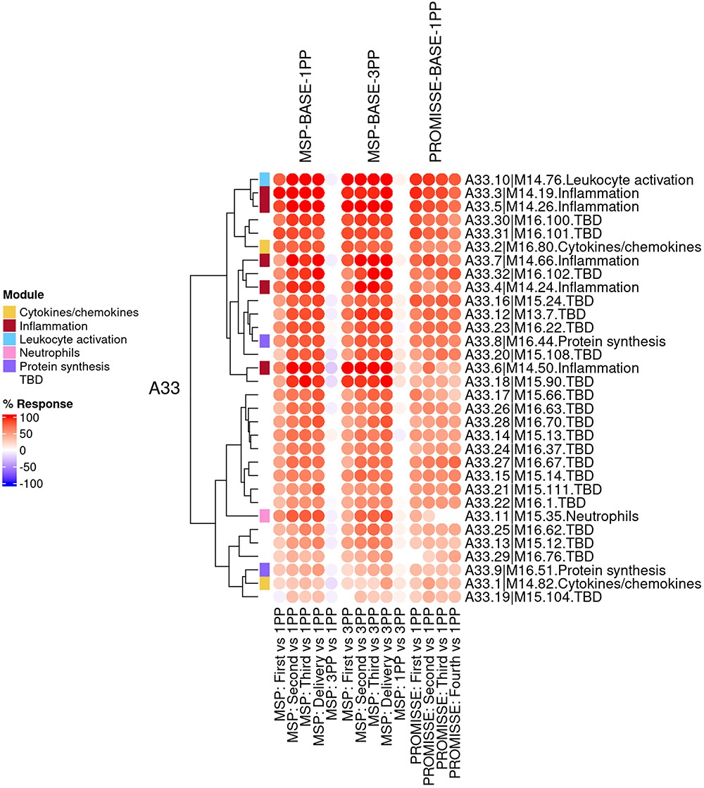
Figure 3. Group-level fingerprint heatmap representation. This heatmap represents changes in transcript abundance for ...
Notes:
Figure 3. Group-level fingerprint heatmap representation. This heatmap represents changes in transcript abundance for individual modules (rows) belonging to a given aggregate (A33 in this example), across MSP and PROMISSE study groups (columns). Groups here are formed according to the sampling time point (first, second or third trimester) and baseline (1 or 3 months post-partum, noted 1PP and 3PP, respectively). Rows and columns are arranged via hierarchical clustering, based on similarities in abundance profiles. The red spots indicate an increase in transcript abundance compared to baseline, with proportions of significant transcripts for the corresponding module ranging from 15% to 100%. The blue spots indicate a decrease in transcript abundance with proportions indicated by negative % values ranging from −15% to −100%. Functional associations for the modules shown on the heatmap are indicated by a color code on the vertical annotation track.
Unless provided in the caption above, the following copyright applies to the content of this slide: © The Author(s) 2024. Published by Oxford University Press.This is an Open Access article distributed under the terms of the Creative Commons Attribution License (https://creativecommons.org/licenses/by/4.0/), which permits unrestricted reuse, distribution, and reproduction in any medium, provided the original work is properly cited.

