Slide 1
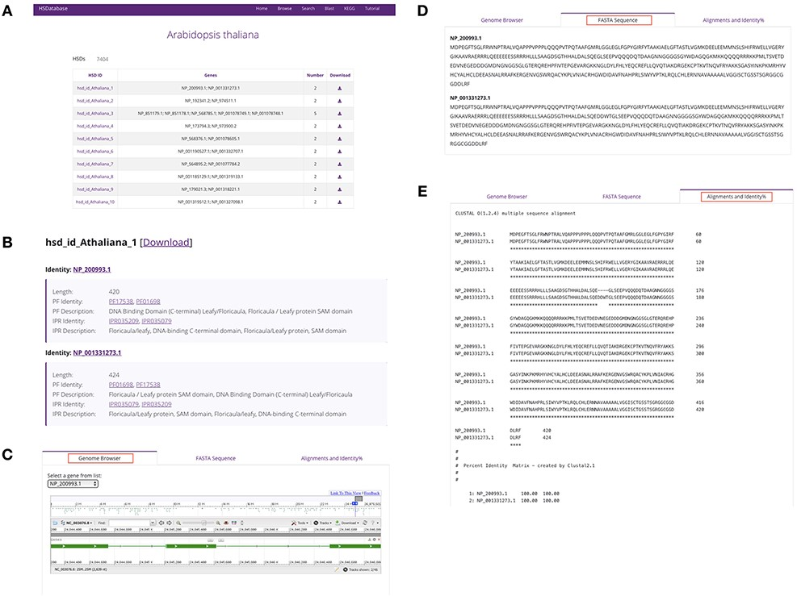
Figure 4. Summary of database information for a selected species. (A) HSDs collected in a table for a specific species. ...
Notes:
Figure 4. Summary of database information for a selected species. (A) HSDs collected in a table for a specific species. (B) Basic information of the unique HSD ID, gene copy ID and the associated links to Pfam domains and InterPro databases. (C) Linking gene copies to the genome browser. (D) The FASTA sequence downloads of gene copies. (E) Alignments and percentage sequence identities of gene copies.
Unless provided in the caption above, the following copyright applies to the content of this slide: © The Author(s) 2022. Published by Oxford University Press.This is an Open Access article distributed under the terms of the Creative Commons Attribution-NonCommercial License (https://creativecommons.org/licenses/by-nc/4.0/), which permits non-commercial re-use, distribution, and reproduction in any medium, provided the original work is properly cited. For commercial re-use, please contact journals.permissions@oup.com

