Slide 1
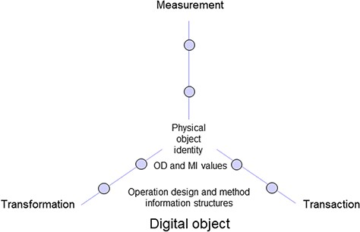
Figure 2 Digital object including information on physical object identity as well as operation design (OD) and method ...
Notes:
Figure 2 Digital object including information on physical object identity as well as operation design (OD) and method information (MI) structures and values of three elementary operation domains.
Unless provided in the caption above, the following copyright applies to the content of this slide: © The Author(s) 2020. Published by Oxford University Press.This is an Open Access article distributed under the terms of the Creative Commons Attribution License (http://creativecommons.org/licenses/by/4.0/), which permits unrestricted reuse, distribution, and reproduction in any medium, provided the original work is properly cited.

