Slide 1
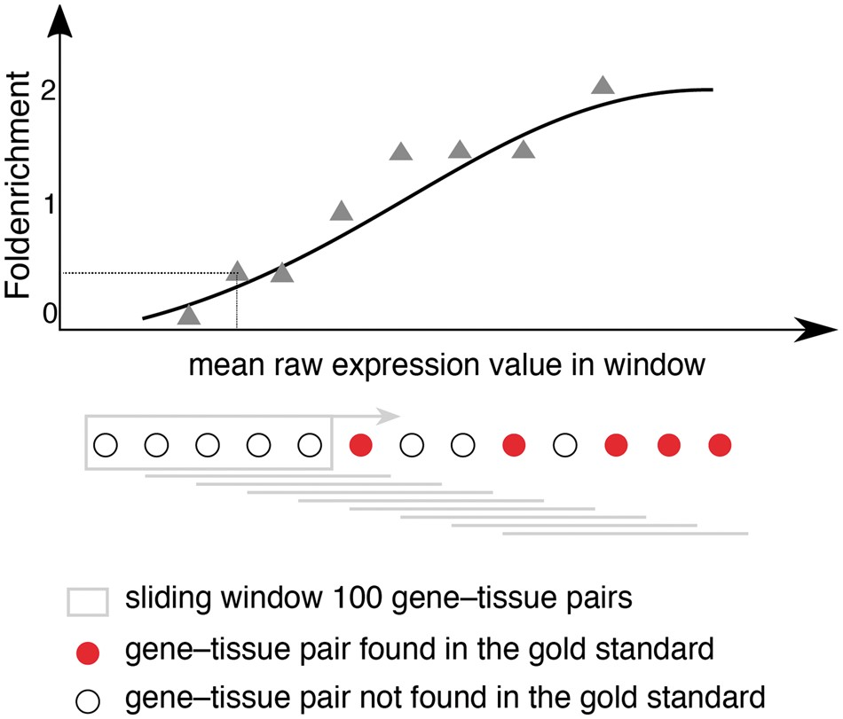
Figure 1. Schematic representation for calculating fold enrichment and fitting its relationship to raw expression ...
Notes:
Figure 1. Schematic representation for calculating fold enrichment and fitting its relationship to raw expression values. For a given dataset, we select gene–tissue pairs and their raw expression scores for a subset of tissues, which are common between all datasets and a subset of genes common between the dataset and the gold standard. Next, we sort these gene–tissue pairs by their raw expression value, and traverse them in sliding windows of a pre-defined size. The enrichment corresponding to each bin is then calculated as the fraction of gene–tissue pairs from that bin found in the gold standard, divided by the fraction of pairs that would be expected by random. Next, we use appropriate functions (see text) to fit the relationship between fold enrichment values and mean raw expression values in their corresponding windows.
Unless provided in the caption above, the following copyright applies to the content of this slide: © The Author(s) 2018. Published by Oxford University Press.This is an Open Access article distributed under the terms of the Creative Commons Attribution License (http://creativecommons.org/licenses/by/4.0/), which permits unrestricted reuse, distribution, and reproduction in any medium, provided the original work is properly cited.

