Slide 1
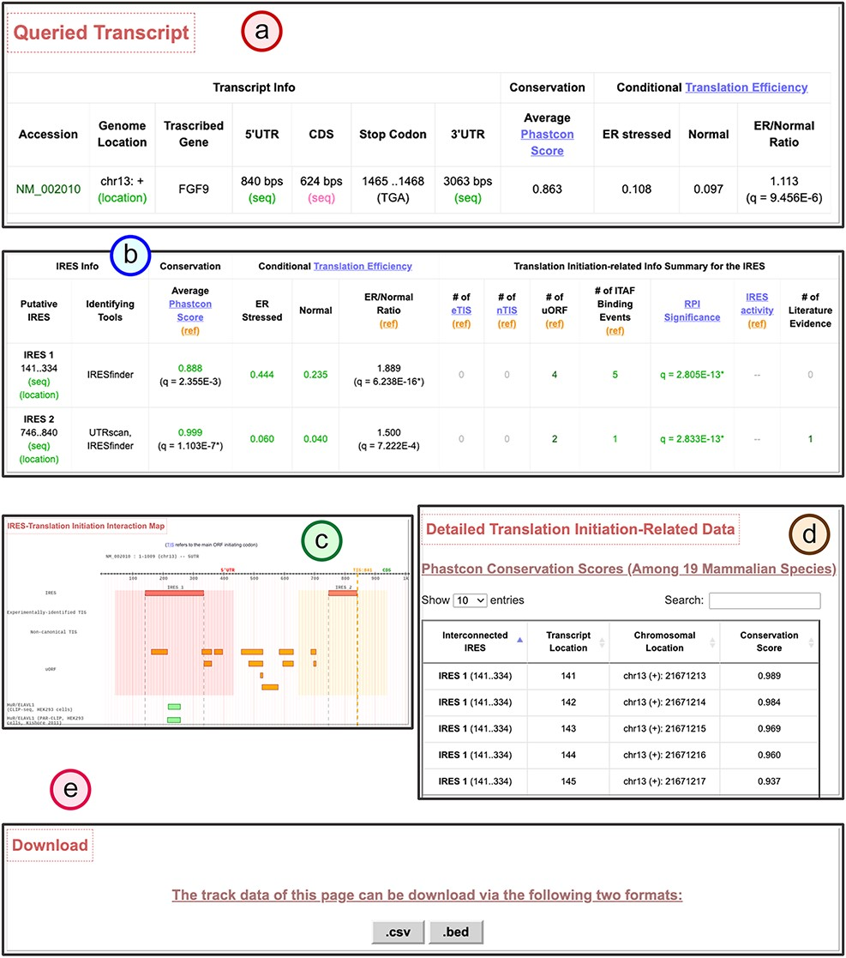
Figure 4. The transcript detail page showing the potential IRES-driven translation regulatory program of the given ...
Notes:
Figure 4. The transcript detail page showing the potential IRES-driven translation regulatory program of the given transcript. (a) The brief information table of the queried gene transcript. (b) The translation initiation–related feature summary table for the identified IRES elements within the queried gene transcript. (c) The IRES–translation initiation interaction map for the queried gene transcript. (d) The detail of the translation initiation–related feature data found for each IRES. (e) The download function to obtain the .csv or .bed formats of all information in the detail page.
Unless provided in the caption above, the following copyright applies to the content of this slide: © The Author(s) 2021. Published by Oxford University Press.This is an Open Access article distributed under the terms of the Creative Commons Attribution License (http://creativecommons.org/licenses/by/4.0/), which permits unrestricted reuse, distribution, and reproduction in any medium, provided the original work is properly cited.

