Slide 1
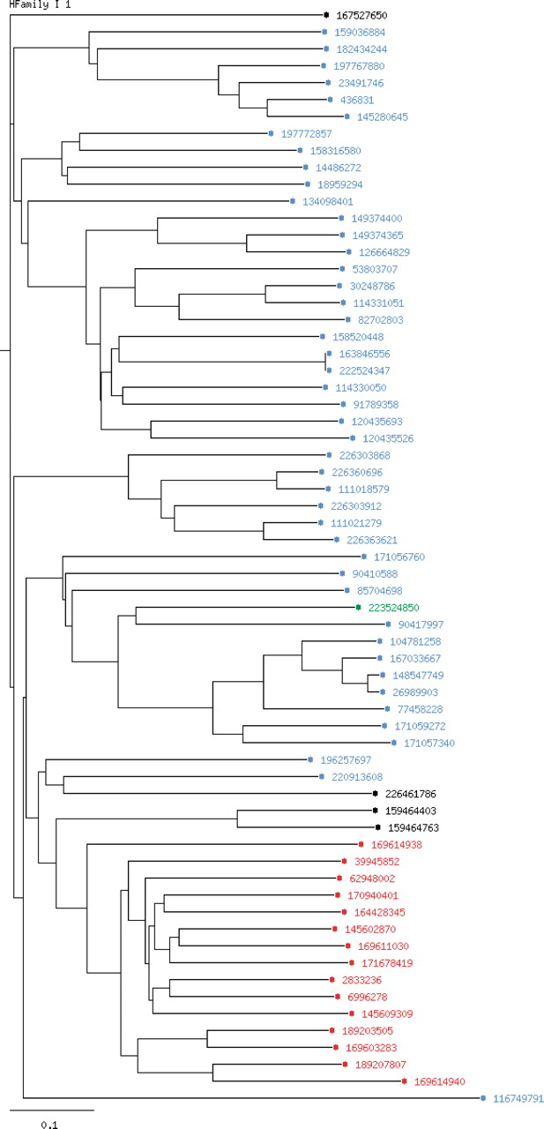
Figure 1. Phylogenetic tree for the homologous family I1 (Bilirubin oxidases).The chosen coloring option is ‘by ...
Notes:
Figure 1. Phylogenetic tree for the homologous family I1 (Bilirubin oxidases).The chosen coloring option is ‘by kingdom’. Entries of bacterial origin are shown in blue, fungal entries in red, plant proteins in green and non-specified entries are colored in black.
Unless provided in the caption above, the following copyright applies to the content of this slide: © The Author(s) 2011. Published by Oxford University Press.This is Open Access article distributed under the terms of the Creative Commons Attribution Non-Commercial License (http://creativecommons.org/licenses/by-nc/2.5), which permits unrestricted non-commercial use, distribution, and reproduction in any medium, provided the original work is properly cited.

