Slide 1
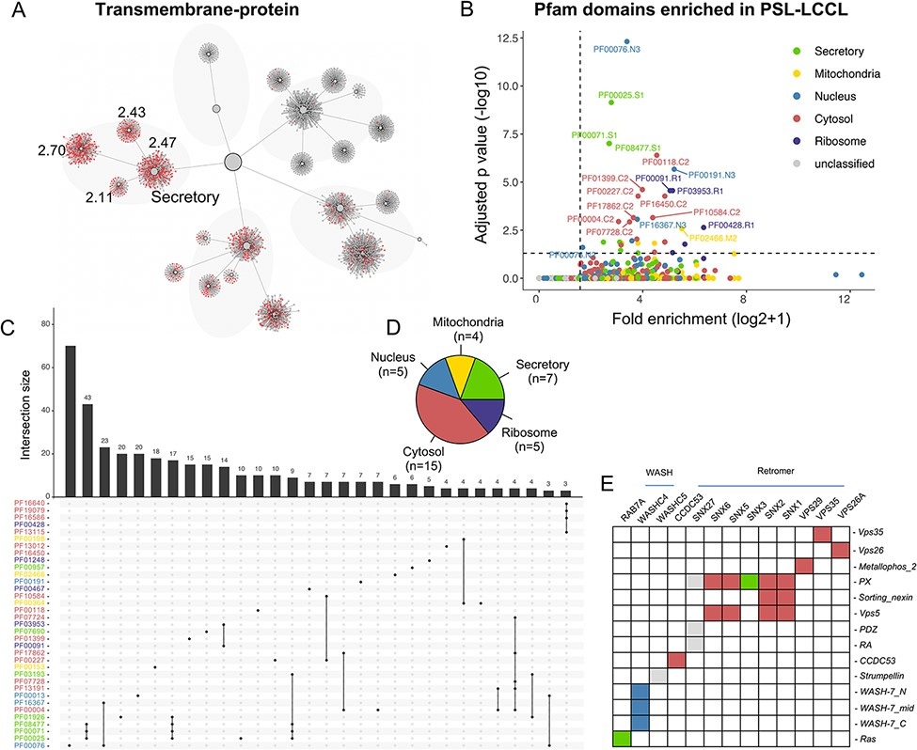
Figure 6. The effects of domains on subcellular proteins localization. (A) The localization of proteins with ...
Notes:
Figure 6. The effects of domains on subcellular proteins localization. (A) The localization of proteins with transmembrane domain in the hierarchical structure. Enriched locations (P < 0.05) are indicated. (B). Enrichment analysis for Pfam domains in our neighborhoods. The cutoff for fold enrichment was two (*adjusted P-value* < 0.05). (C). Protein domains significantly enriched in PSL-LCCL. (D) The number of protein domains that are significantly enriched in neighborhoods. (E) The domain of the retromer complex.
Unless provided in the caption above, the following copyright applies to the content of this slide: © The Author(s) 2022. Published by Oxford University Press.This is an Open Access article distributed under the terms of the Creative Commons Attribution License (https://creativecommons.org/licenses/by/4.0/), which permits unrestricted reuse, distribution, and reproduction in any medium, provided the original work is properly cited.

