Slide 1
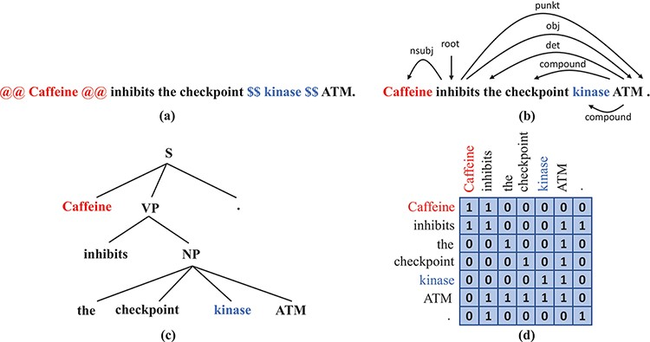
Figure 2. Syntax representations that we obtain from off-the-shelf parsers: (a) A sentence with the subject and the ...
Notes:
Figure 2. Syntax representations that we obtain from off-the-shelf parsers: (a) A sentence with the subject and the object wrapped by markers. (b) The dependency tree of the sentence in (a). (c) The constituency tree of the sentence in (a). (d) The adjacency matrix that corresponds to the dependency tree in (b).
Unless provided in the caption above, the following copyright applies to the content of this slide: © The Author(s) 2022. Published by Oxford University Press.This is an Open Access article distributed under the terms of the Creative Commons Attribution-NonCommercial License (https://creativecommons.org/licenses/by-nc/4.0/), which permits non-commercial re-use, distribution, and reproduction in any medium, provided the original work is properly cited. For commercial re-use, please contact journals.permissions@oup.com

