Slide 1
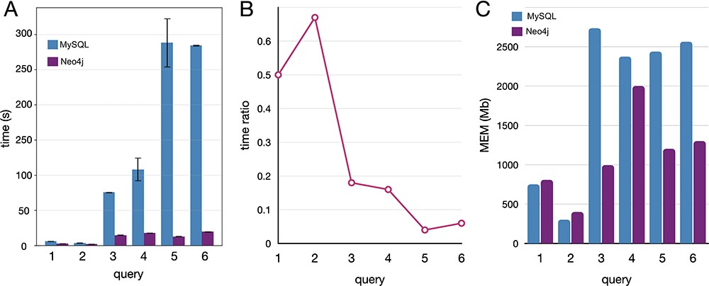
Figure 5. Comparative benchmarks of the computational performances between Neo4J and MySQL databases applied to ...
Notes:
Figure 5. Comparative benchmarks of the computational performances between Neo4J and MySQL databases applied to real-case queries, here reported with five instances covering different operations. (A) Time in seconds, with variance (whiskers) for the replicates, scaled to log10; (B) time ratio between Neo4j and MySQL (query time Neo4j/MySQL); (C) the memory utilization in megabytes.
Unless provided in the caption above, the following copyright applies to the content of this slide: © The Author(s) 2023. Published by Oxford University Press.This is an Open Access article distributed under the terms of the Creative Commons Attribution License (https://creativecommons.org/licenses/by/4.0/), which permits unrestricted reuse, distribution, and reproduction in any medium, provided the original work is properly cited.

