Slide 1
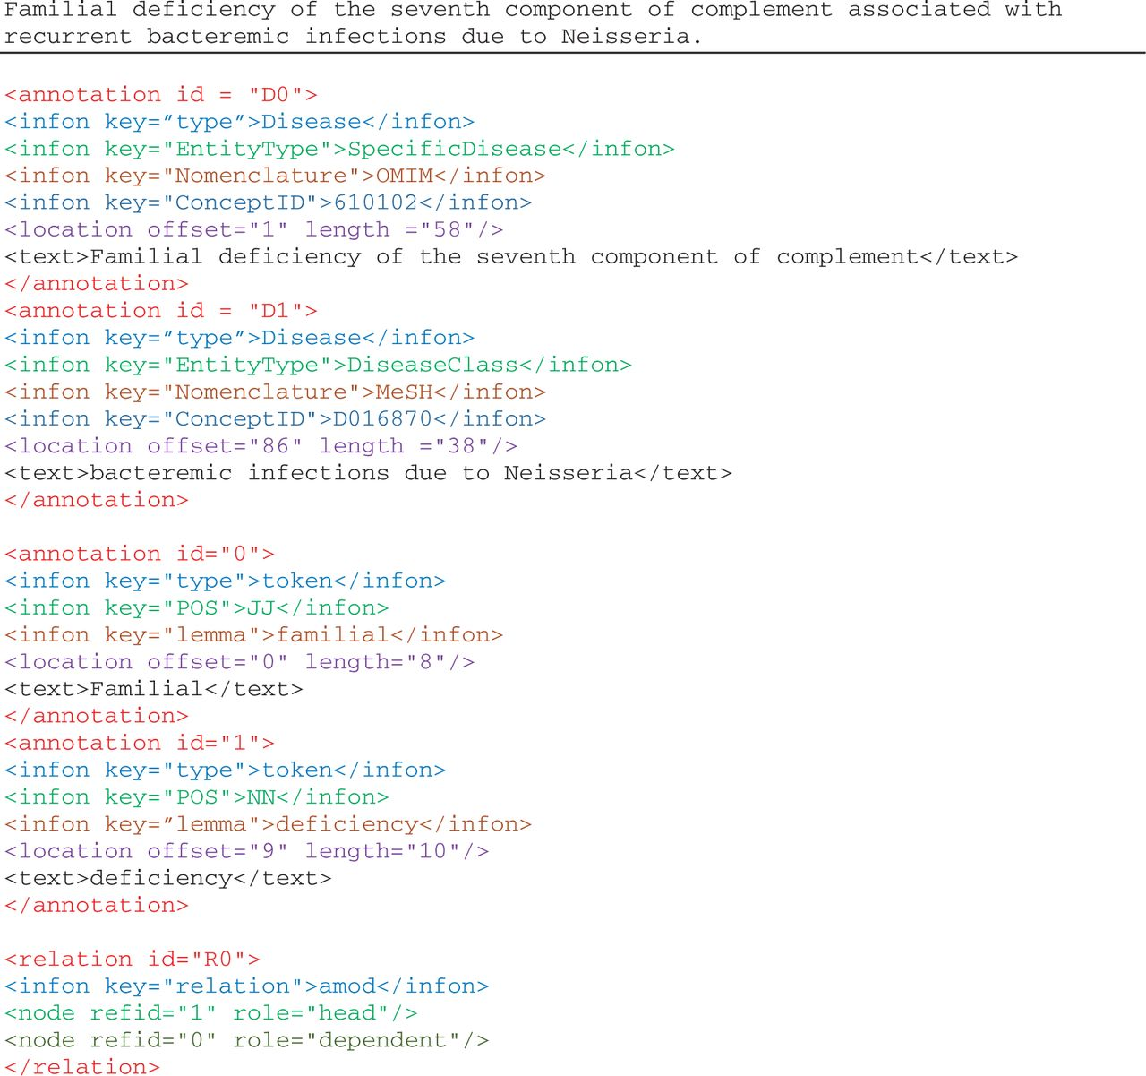
Figure 2. Illustration of annotations in the enriched NCBI disease corpus, manual annotations of disease mentions and ...
Notes:
Figure 2. Illustration of annotations in the enriched NCBI disease corpus, manual annotations of disease mentions and concepts, and BioC-tool-produced annotations from text preprocessing.
Unless provided in the caption above, the following copyright applies to the content of this slide: Published by Oxford University Press. This work is written by US Government employees and is in the public domain in the US.

