Slide 1
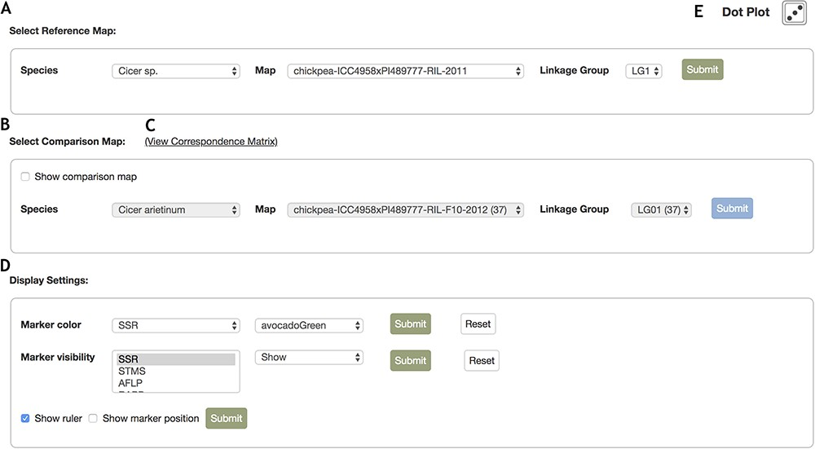
Figure 4 Control Panel interface for the MapViewer main page. The control panel provides configuration options for the ...
Notes:
Figure 4 Control Panel interface for the MapViewer main page. The control panel provides configuration options for the display of linkage groups, markers and rulers. A. The reference map can be configured with the drop list selector toolbar. After selecting a species, the options for maps belonging to the species are automatically updated and similarly, selecting a map automatically updates the linkage group field with all relevant linkage group display options. B. Interface where the comparison linkage group is specified. When the map or linkage group in the reference toolbar is modified, the comparison map toolbar is automatically updated with maps and linkage groups that contain correspondences to the reference map and linkage group. Additionally, map and linkage group fields provide the number of marker correspondences in parentheses beside the items in the map and linkage group fields to provide better informed browsing choices. C. Links to the Correspondence Matrix page launching graphical display of correspondences for the reference and comparison map. D. Marker color and visibility controls for the reference and comparison linkage groups. E. Launches Dot plot display for markers in common between reference and comparison linkage groups.
Unless provided in the caption above, the following copyright applies to the content of this slide: © The Author(s) 2019. Published by Oxford University Press.This work is written by US Government employees and is in the public domain in the US.

