Slide 1
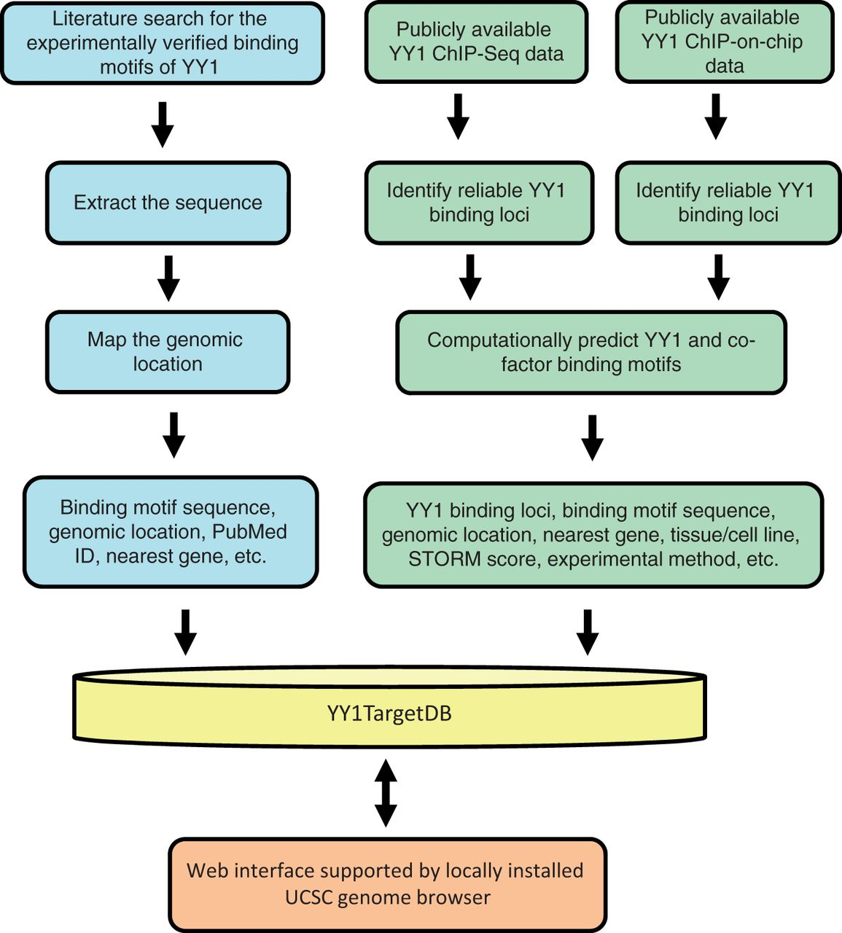
Figure 1 Schematic overview for YY1TargetDB data acquisition and database implementation. The experimentally verified ...
Notes:
Figure 1 Schematic overview for YY1TargetDB data acquisition and database implementation. The experimentally verified YY1-binding motifs were collected from literatrues, mapped to the reference genomes and stored in the database. High-throughput (ChIP-seq or ChIP-on-chip) experimental datasets were downloaded from NCBI GEO server and processed by our analysis and annotation pipeline. The identifed YY1-binding loci, computationally predicted YY1 and its cofactors binding motifs were deposited into YY1TargetDB. The database in integrated with locally installed UCSC genome browser to visualize YY1-binding loci and assoicated annotation information.
Unless provided in the caption above, the following copyright applies to the content of this slide: © The Author(s) 2013. Published by Oxford University Press.This is an Open Access article distributed under the terms of the Creative Commons Attribution Non-Commercial License (http://creativecommons.org/licenses/by-nc/3.0/), which permits unrestricted non-commercial use, distribution, and reproduction in any medium, provided the original work is properly cited.

