Slide 1
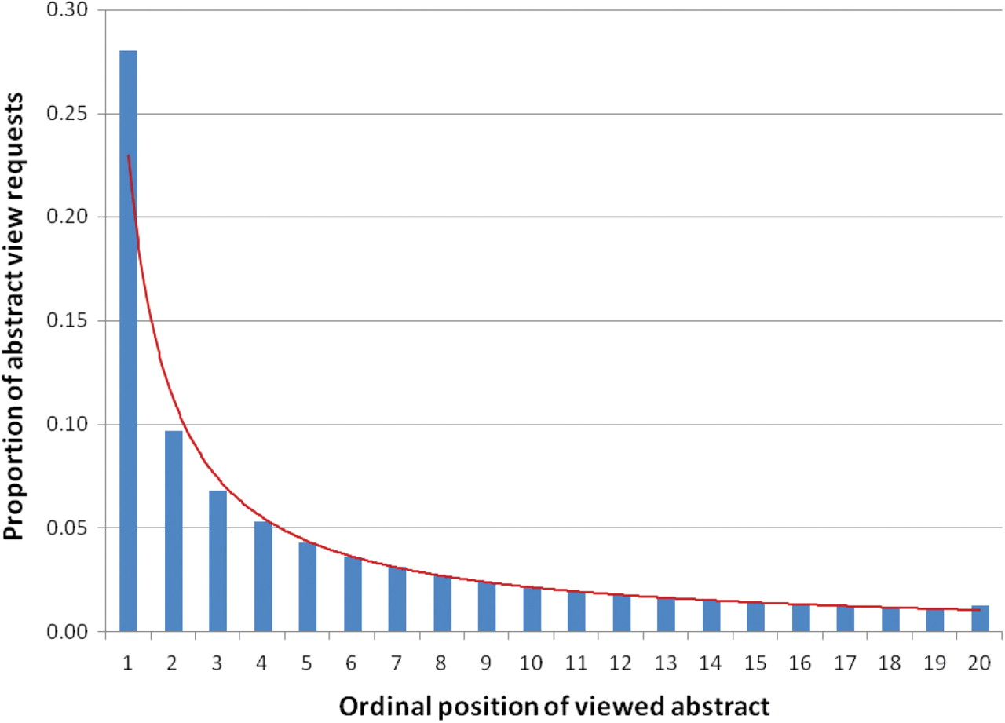
Figure 7. Distribution of abstract view requests for ordinal positions of the first page of results (data follows a ...
Notes:
Figure 7. Distribution of abstract view requests for ordinal positions of the first page of results (data follows a Power law shown with the red line).
Unless provided in the caption above, the following copyright applies to the content of this slide: © The Author(s) 2009. Published by Oxford University Press.This is Open Access article distributed under the terms of the Creative Commons Attribution Non-Commercial License (http://creativecommons.org/licenses/by-nc/2.5/uk/) which permits unrestricted non-commercial use, distribution, and reproduction in any medium, provided the original work is properly cited.

