Slide 1
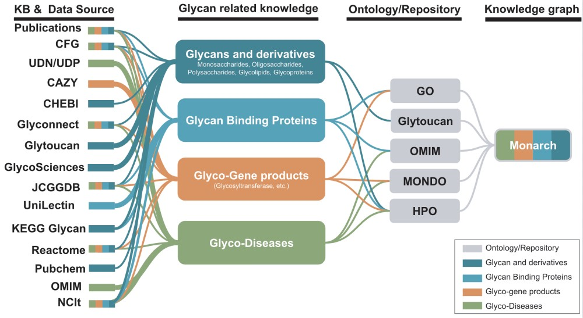
Figure 4 Potential KBs and data sources for the improvement of glycophenotypes representation for HPO and Monarch ...
Notes:
Figure 4 Potential KBs and data sources for the improvement of glycophenotypes representation for HPO and Monarch glycophenotypes related to diseases indicated in publications and KBs could be used to enhance glycan-related knowledge in Monarch.
Unless provided in the caption above, the following copyright applies to the content of this slide: © The Author(s) 2019. Published by Oxford University Press.This is an Open Access article distributed under the terms of the Creative Commons Attribution License (http://creativecommons.org/licenses/by/4.0/), which permits unrestricted reuse, distribution, and reproduction in any medium, provided the original work is properly cited.

