Slide 1
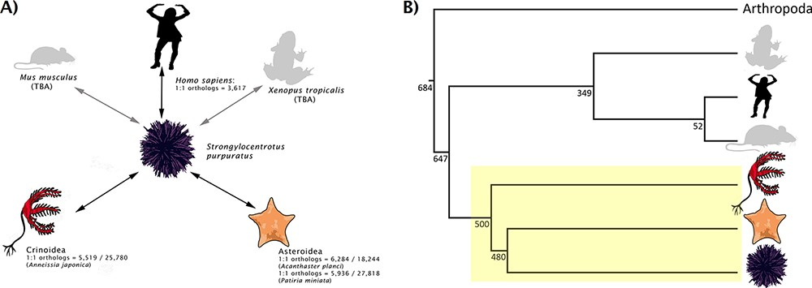
Figure 1. (A) Rationale behind taxon choice for orthology analyses at Echinobase. Black arrows represent analyses that ...
Notes:
Figure 1. (A) Rationale behind taxon choice for orthology analyses at Echinobase. Black arrows represent analyses that have been performed. We have so far used Anneissia japonica for Crinoidea analysis and both Acanthaster planci and Patiria miniata for Asteroidea. Gray arrows show analyses planned for integration (e.g. between S. purpuratus and Mus musculus, Xenopus tropicalis). This demonstrates our use as S. purpuratus as our reference echinoderm, in that orthologs can be laterally inferred between other echinoderms and non-echinoderms via S. purpuratus. 1:1 ortholog counts for intra-echinoderm analyses are expressed as fractions of the total number of genes in the genome of that species. (B) A species tree, showing the phylogenetic positions of different model metazoan taxa relative to echinoderms (box highlighted in yellow). Branch lengths are not drawn to scale. Numbers beside the nodes are estimated times in millions of years which, along with the topology, are adapted from the studies by Cary and Hinman, Delsuc et al. and Dohrmann and Wörheide (34–36). Echinoderms are an extremely diverse group; different classes of echinoderm are distantly related to each other.
Unless provided in the caption above, the following copyright applies to the content of this slide: © The Author(s) 2021. Published by Oxford University Press.This is an Open Access article distributed under the terms of the Creative Commons Attribution License (http://creativecommons.org/licenses/by/4.0/), which permits unrestricted reuse, distribution, and reproduction in any medium, provided the original work is properly cited.

