Slide 1
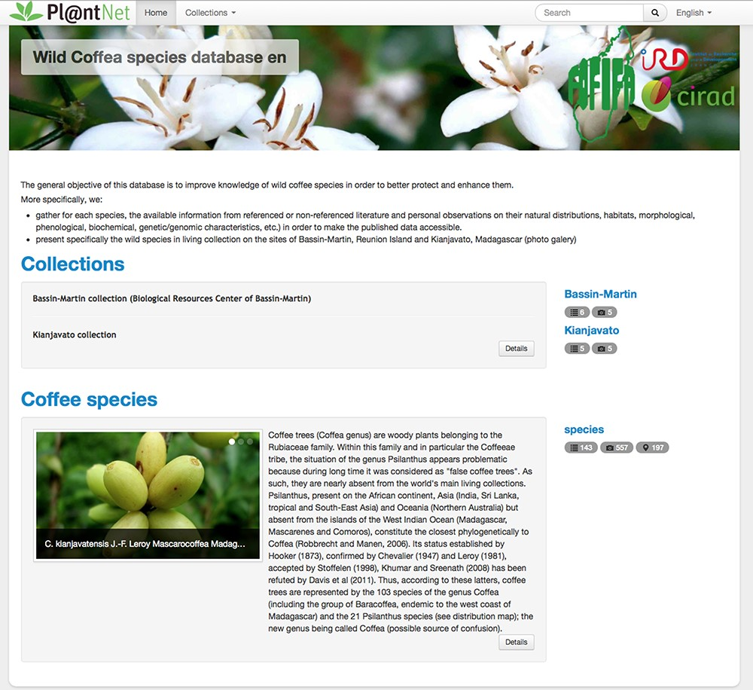
Figure 2. Home page of the wild coffee species database (http://publish.plantnet-project.org/project/wildcofdb_en).
Notes:
Figure 2. Home page of the wild coffee species database (http://publish.plantnet-project.org/project/wildcofdb_en).
Unless provided in the caption above, the following copyright applies to the content of this slide: © Crown copyright 2020.This Open Access article contains public sector information licensed under the Open Government Licence v2.0 (http://www.nationalarchives.gov.uk/doc/open-government-licence/version/2/).

