Slide 1
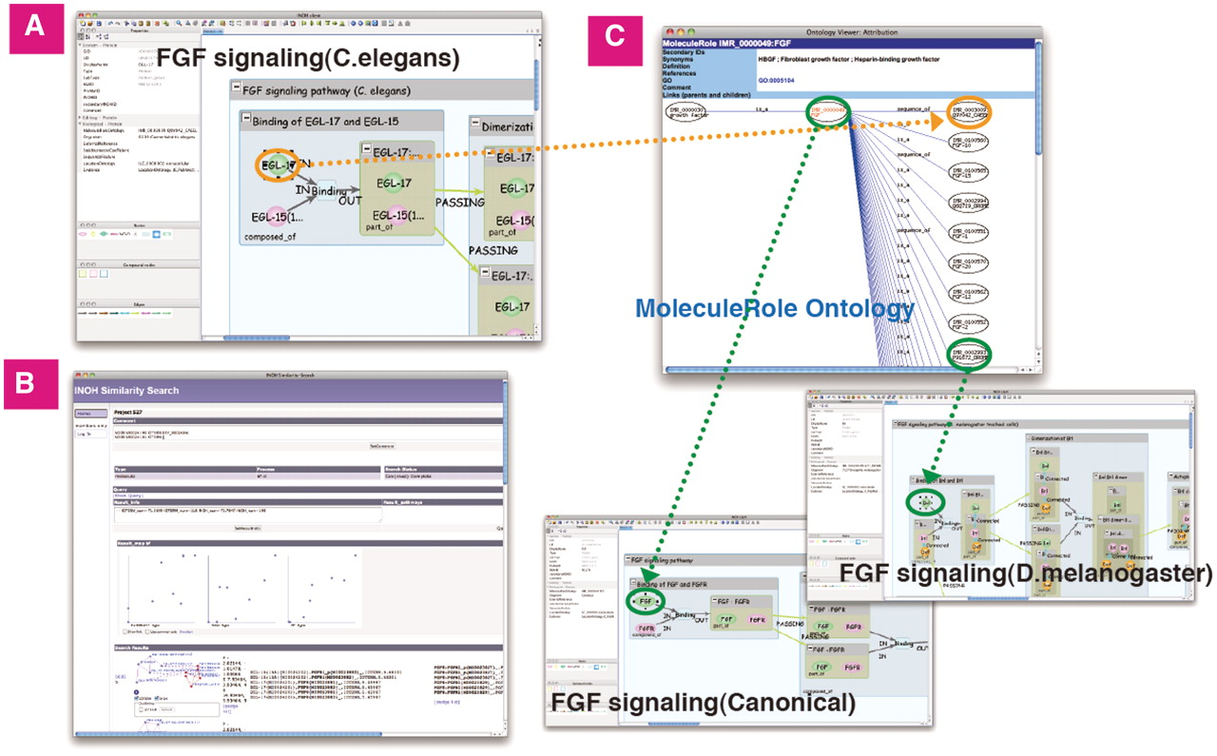
Figure 7. Similarity Search of FGF signaling (C.elegans). (A) The ligand-receptor binding in FGF signaling (C.elegans). ...
Notes:
Figure 7. Similarity Search of FGF signaling (C.elegans). (A) The ligand-receptor binding in FGF signaling (C.elegans). (B) Result screen of similarity search. (C) The hierarchical tree of ‘FGF’ molecule in MoleculeRole ontology and some signaling pathways similar to FGF signaling (C.elegans). Green/orange edges represent correspondence relation to MoleculeRole ontology.
Unless provided in the caption above, the following copyright applies to the content of this slide: © The Author(s) 2011. Published by Oxford University Press.This is an Open Access article distributed under the terms of the Creative Commons Attribution Non-Commercial License (http://creativecommons.org/licenses/by-nc/3.0), which permits unrestricted non-commercial use, distribution, and reproduction in any medium, provided the original work is properly cited.

