Slide 1
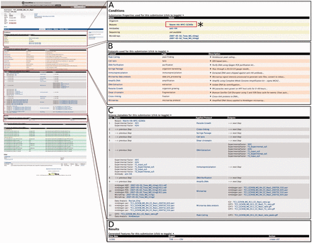
Figure 2. An example of the Report page. Here, we focus on submission ‘TC1’ to illustrate that a customized report page ...
Notes:
Figure 2. An example of the Report page. Here, we focus on submission ‘TC1’ to illustrate that a customized report page contains information from a range of associated data sets. (A) (*) Users can click on the Mutants link to seek additional experiments or projects that used this mutant. This will lead users to a report page for that particular data entry. (B) List of all protocols involved in this submission with type and description of protocol displayed. (C) Report page lists all of the data generated and detailed applied protocol information including antibody, mutant and the type of software used to generate the data. (D) The resulting data for the submission can be exported into a number of different formats, e.g. TAB and CSV. Additionally, result data can be exported as a ‘list’ for further analysis.
Unless provided in the caption above, the following copyright applies to the content of this slide: © The Author(s) 2015. Published by Oxford University Press. This is an Open Access article distributed under the terms of the Creative Commons Attribution License ( http://creativecommons.org/licenses/by/4.0/ ), which permits unrestricted reuse, distribution, and reproduction in any medium, provided the original work is properly cited.

