Slide 1
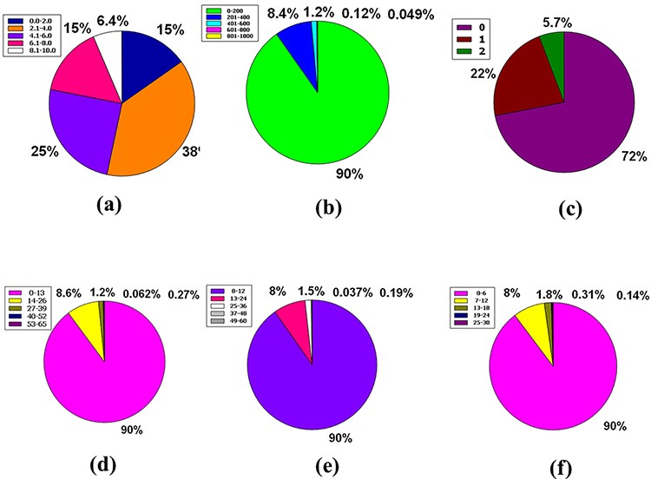
Figure 7. Venn diagram plot display of the physicochemical properties of phytochemicals in ‘phytochemdb’ database: (a) ...
Notes:
Figure 7. Venn diagram plot display of the physicochemical properties of phytochemicals in ‘phytochemdb’ database: (a) proportions of compounds’ synthetic accessibility; (b) proportions of phytochemicals that show diverse standards of TPSA; (c) percentages of phytochemicals according to the Veber filter; (d) proportions of compounds that fulfil different standards of rotatable bonds; (e) and (f) percentages of phytochemicals that satisfy various criteria of H bond acceptors and H bond donors, respectively.
Unless provided in the caption above, the following copyright applies to the content of this slide: © The Author(s) 2022. Published by Oxford University Press.This is an Open Access article distributed under the terms of the Creative Commons Attribution License (https://creativecommons.org/licenses/by/4.0/), which permits unrestricted reuse, distribution, and reproduction in any medium, provided the original work is properly cited.

