Slide 1
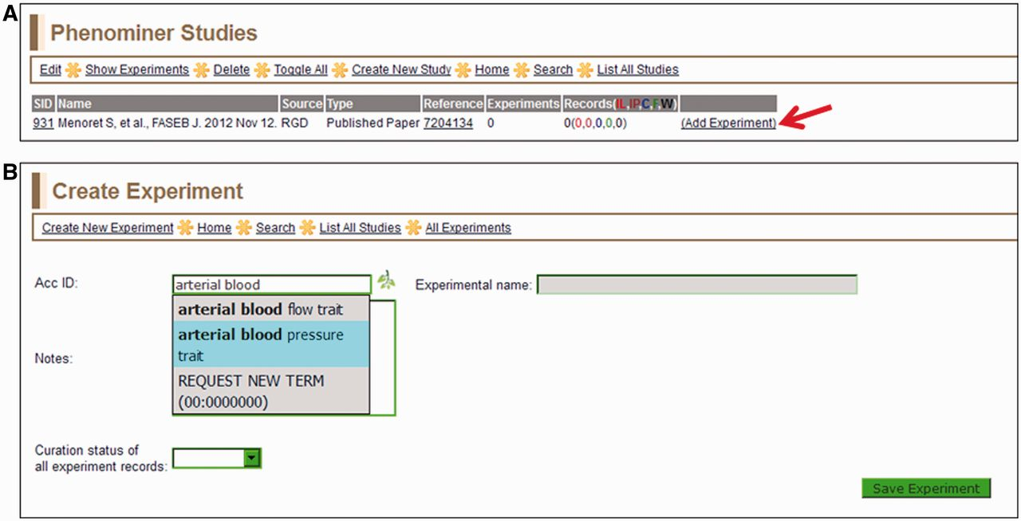
Figure 2 (A) Selected study page—this page displays the citation, a reference link and other information about the ...
Notes:
Figure 2 (A) Selected study page—this page displays the citation, a reference link and other information about the study. Clicking the ‘Add Experiment’ link (red arrow) returns the ‘Create Experiment’ page. (B) Create Experiment page—this page features an autocompleting text box for entering term IDs for either vertebrate trait terms (VT) or disease terms (RDO). The text box will accept a VT or RDO ID or any key word(s) found in VT or RDO terms. If a suggested term is selected, the ID is automatically entered in the selection text box and the term itself will be automatically entered in the accompanying ‘Experimental name’ box.
Unless provided in the caption above, the following copyright applies to the content of this slide: © The Author(s) 2013. Published by Oxford University Press.This is an Open Access article distributed under the terms of the Creative Commons Attribution Non-Commercial License (http://creativecommons.org/licenses/by-nc/3.0/), which permits unrestricted non-commercial use, distribution, and reproduction in any medium, provided the original work is properly cited.

