Slide 1
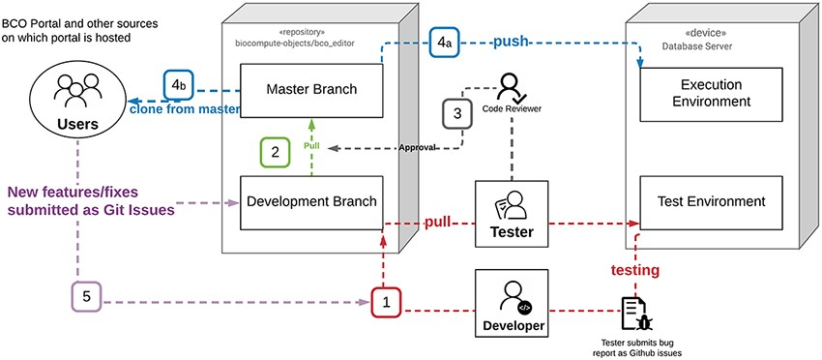
Figure 2. BCO portal deployment diagram.
Notes:
Figure 2. BCO portal deployment diagram. (1) Testing: the developer worked in the Development environment, and once a new version was ready for testing it was pushed from the development branch in GitHub to the Test Environment. In the event testing of the new code generated a bug report, a GitHub issue was created for each bug. The developer then addressed the GitHub issues in the development environment and closed issues with commits to the development branch, which was then tested again. This cycle repeated until no issues remained. (2) Pull Request: once the test code was free of bugs the developer assigned a version, rebased and made a pull request from the development branch to the master branch (the master was set as a protected branch). (3) Approval: all pull requests required the review and approval of two administrators, who checked the commit history, bug fixes, etc. Once a pull request was approved, the new version was assigned the appropriate number and listed as a new release. (4) a. The new stable release was pushed to the Execution Environment (biocomputeobject.org) and b. became available for others to clone into their own environments. (5) New features and potential fixes were submitted to GitHub as issues. These issues were triaged and if warranted, incorporated into the next round of development.
Unless provided in the caption above, the following copyright applies to the content of this slide: © Oxford University Press 2021.This is an Open Access article distributed under the terms of the Creative Commons Attribution License (http://creativecommons.org/licenses/by/4.0/), which permits unrestricted reuse, distribution, and reproduction in any medium, provided the original work is properly cited.

Slide 2
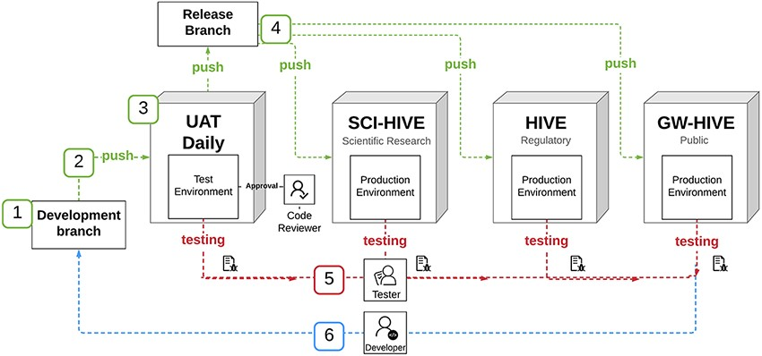
Figure 1. HIVE BCO App deployment diagram.
Notes:
Figure 1. HIVE BCO App deployment diagram. Once the (1) HIVE BCO App was developed in the development branch, (2) the code was then pushed from development branch to testing environment. (3) The code was tested in the User Acceptance Testing (UAT) Daily environment, and (4) once approved, code was pushed out to production environments (FDA-SCI-HIVE, FDA-HIVE and Public-HIVE which are different HIVE installations at FDA and GW). (5) New code was tested and verified on each environment, with the tester submitting a report to the developer, who (6) addresses bugs in the development branch.
Unless provided in the caption above, the following copyright applies to the content of this slide: © Oxford University Press 2021.This is an Open Access article distributed under the terms of the Creative Commons Attribution License (http://creativecommons.org/licenses/by/4.0/), which permits unrestricted reuse, distribution, and reproduction in any medium, provided the original work is properly cited.

Slide 3
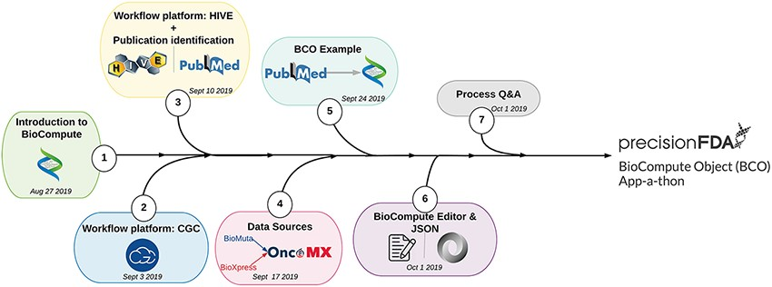
Figure 3. User BCO training process.
Notes:
Figure 3. User BCO training process. The BioCompute training unit (1) introduced participants to the concept of BioCompute, (2) offered hands-on exercises with two genome analysis platforms (HIVE and CGC), (3) familiarized participants with a prominent literature resource (PubMed), (4) introduced the concept of data sources [through the OncoMX knowledgebase (https://www.oncomx.org/)], (5) described the process of finding a suitable publication with an associated open source pipeline, (6) introduced the JSON language as a suitable segue into training users on the BCO Portal (previously BCO Editor) and (7) provided users with a Q&amp;A opportunity prior to final submission of BCOs to the precisionFDA BCO App-a-thon.
Unless provided in the caption above, the following copyright applies to the content of this slide: © Oxford University Press 2021.This is an Open Access article distributed under the terms of the Creative Commons Attribution License (http://creativecommons.org/licenses/by/4.0/), which permits unrestricted reuse, distribution, and reproduction in any medium, provided the original work is properly cited.

