Slide 1
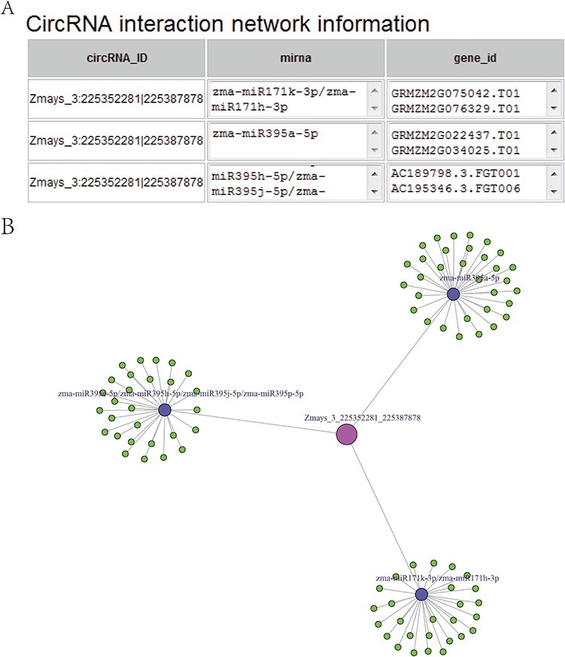
Figure 5 (A) CircRNA–miRNA–mRNA sub-network, taking circRNA Zmays_3:225352281|225 387 878 as an example. Blue nodes, ...
Notes:
Figure 5 (A) CircRNA–miRNA–mRNA sub-network, taking circRNA Zmays_3:225352281|225 387 878 as an example. Blue nodes, miRNA. Pink node, circRNA as a miRNA decoy. Green nodes, mRNAs as miRNA targets. Gray edges, correlations. (B) Sequence list for Figure 5A, taking circRNA Zmays_3: 225352281|225 387 878 as an example. The first column is a circRNA that acts as a miRNA decoy, the second column shows miRNAs and the third column contains mRNAs that act as miRNA targets. This circRNA may act as a decoy for three miRNAs: zma-miR171k-3p/zma-miR171h-3p, zma-miR395a-5p and zma-miR395e-5p/zma-miR395h-5p/zma-miR395j-5p/zma-miR395p-5p.
Unless provided in the caption above, the following copyright applies to the content of this slide: © The Author(s) 2020. Published by Oxford University Press.This is an Open Access article distributed under the terms of the Creative Commons Attribution License (http://creativecommons.org/licenses/by/4.0/), which permits unrestricted reuse, distribution, and reproduction in any medium, provided the original work is properly cited.

