Slide 1
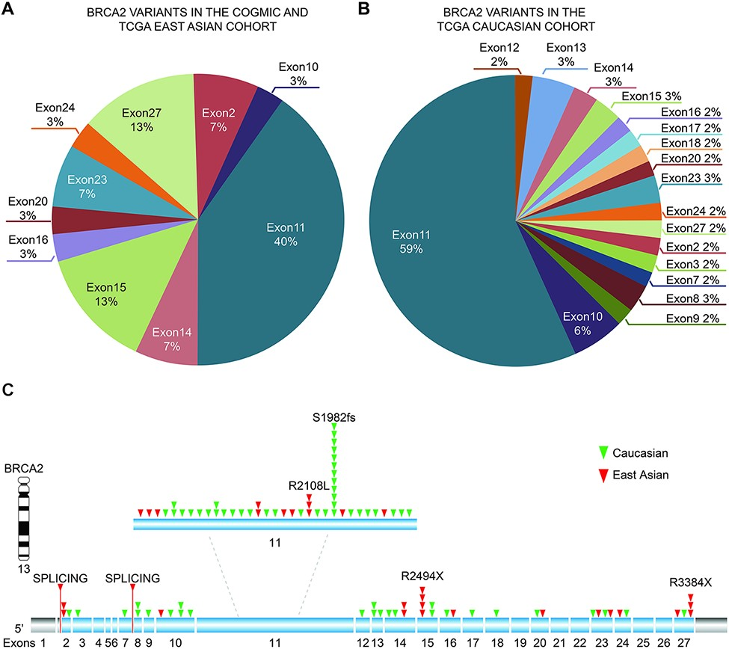
Figure 3. Distribution of identified pathogenic variants of BRCA2 around the world. (A) The proportion of BRCA2 ...
Notes:
Figure 3. Distribution of identified pathogenic variants of BRCA2 around the world. (A) The proportion of BRCA2 variants in different exons in Asian cases from the COGVIC and TCGA cohorts. The colors represent different exons, e.g. exon 1 and exon 2. (B) The proportion of BRCA2 variants in different exons in the TCGA Caucasian cohort. The colors are consistent with the exons shown in A. (C) All variants placed on the BRCA2 gene map. The numbers indicate the exon numbers. The detected variants are indicated by arrows. Red arrows represent the East Asian population, whereas the green arrows represent the Caucasian population. There are two splicing mutations, one between exons 1 and 2 and one between exons 7–8.
Unless provided in the caption above, the following copyright applies to the content of this slide: © The Author(s) 2021. Published by Oxford University Press.This is an Open Access article distributed under the terms of the Creative Commons Attribution License (https://creativecommons.org/licenses/by/4.0/), which permits unrestricted reuse, distribution, and reproduction in any medium, provided the original work is properly cited.

