Slide 1
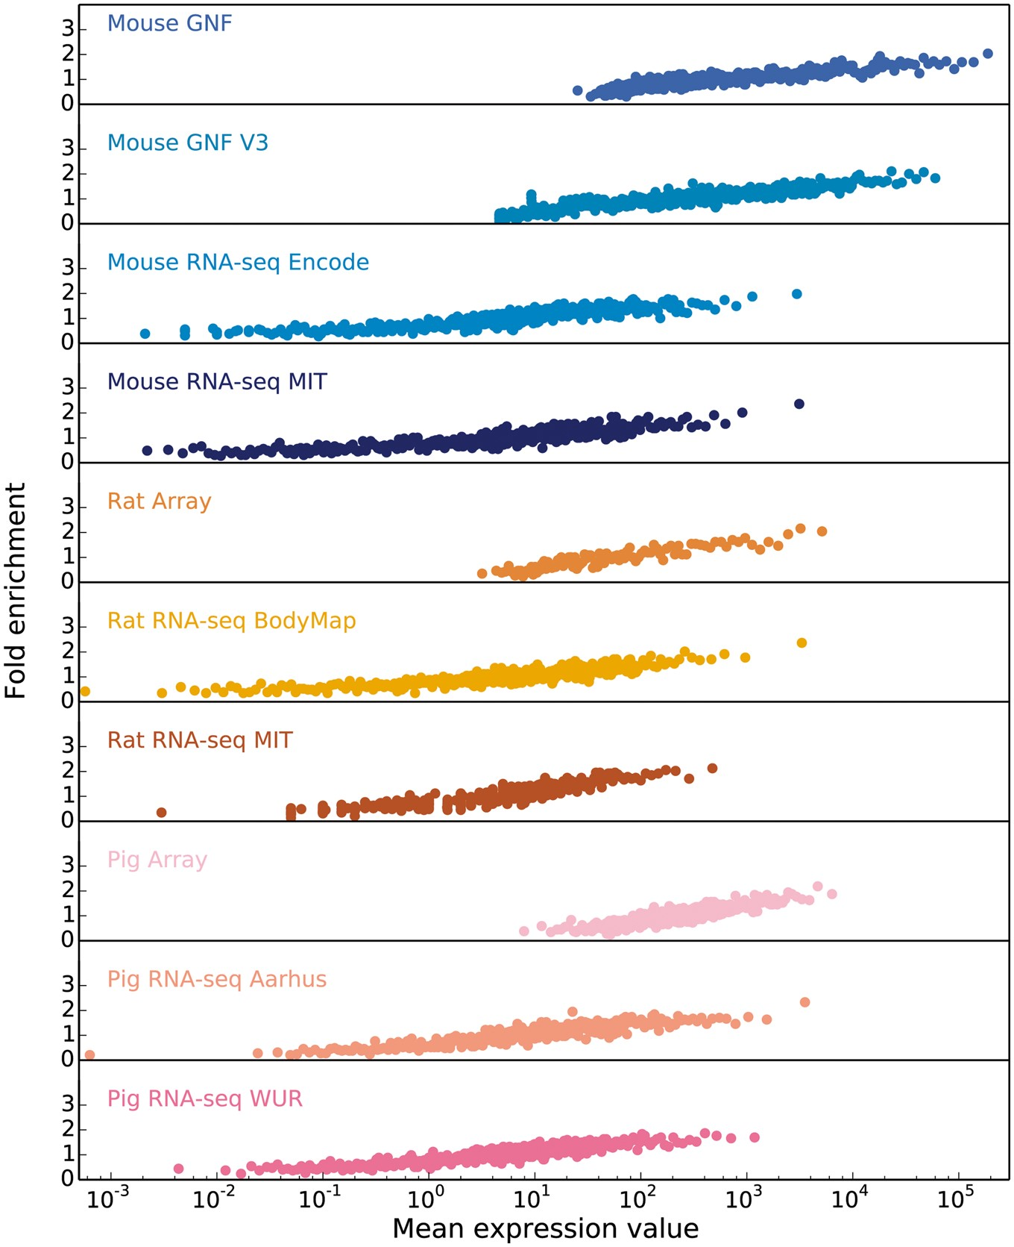
Figure 3. In order to obtain confidence scores for each gene–tissue pair, we assess the relationship between raw ...
Notes:
Figure 3. In order to obtain confidence scores for each gene–tissue pair, we assess the relationship between raw expression values and fold enrichment, defined as the agreement between each dataset and gold standard datasets specific to the organism. The gold standard datasets are based on the UniProtKB protein tissue annotations in human, filtered for 1-to-1 orthologs between human and each of the three organisms. The x-axis contains raw expression values for gene–tissue pairs, in units specific to the type of experiment or processing of data (e.g. intensity units for microarray studies, FPKMs for RNA-seq), and averaged across bins of 100 pairs.
Unless provided in the caption above, the following copyright applies to the content of this slide: © The Author(s) 2018. Published by Oxford University Press.This is an Open Access article distributed under the terms of the Creative Commons Attribution License (http://creativecommons.org/licenses/by/4.0/), which permits unrestricted reuse, distribution, and reproduction in any medium, provided the original work is properly cited.

