Slide 1
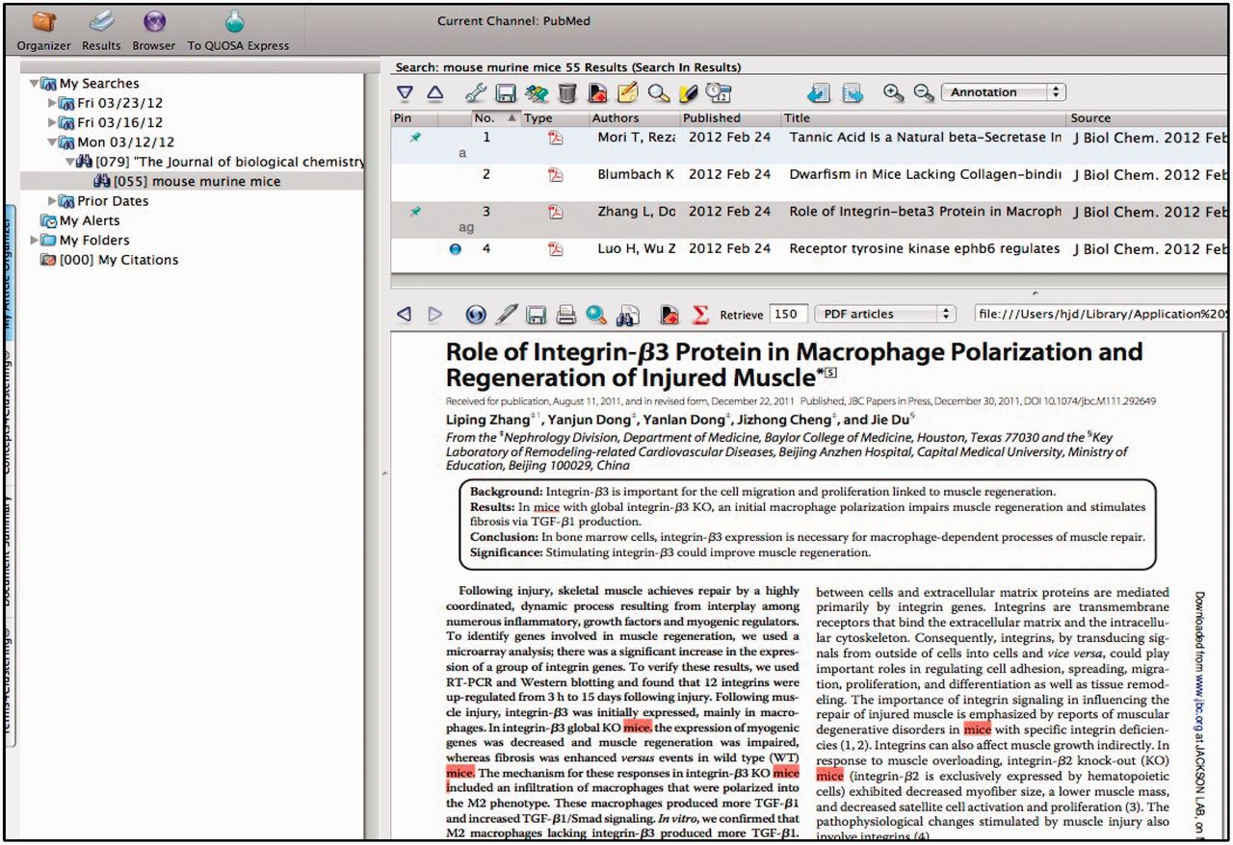
Figure 2. QUOSA Information Manager showing part of a paper from an issue of JBC with mouse, murine or mice ...
Notes:
Figure 2. QUOSA Information Manager showing part of a paper from an issue of JBC with mouse, murine or mice highlighted. Curator quickly looks at context to select appropriate area of MGI that the paper best fits. The paper shown has been ‘tagged’ for alleles and GO.
Unless provided in the caption above, the following copyright applies to the content of this slide: © The Author(s) 2012. Published by Oxford University Press.This is an Open Access article distributed under the terms of the Creative Commons Attribution License (http://creativecommons.org/licenses/by-nc/3.0/), which permits non-commercial reuse, distribution, and reproduction in any medium, provided the original work is properly cited. For commercial re-use, please contact journals.permissions@oup.com.

