Slide 1
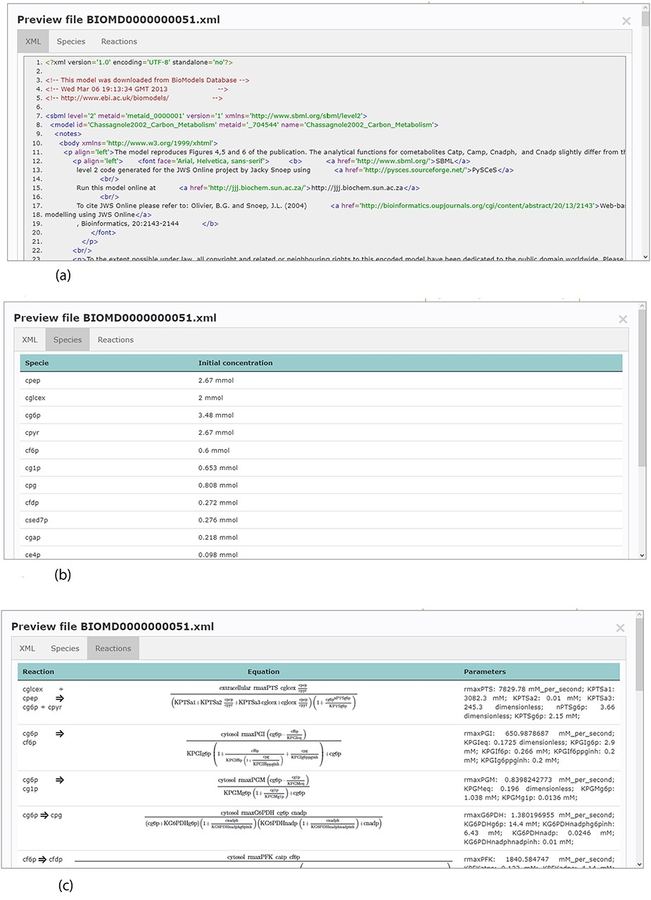
Figure 4. Example of an SBML model file preview (Model EntryID 13). (a) Snapshot of the XML file preview. (b) ...
Notes:
Figure 4. Example of an SBML model file preview (Model EntryID 13). (a) Snapshot of the XML file preview. (b) Screenshot for the model species and initial concentrations. (c) Screenshot of the model reactions, rate equations and kinetic parameters.
Unless provided in the caption above, the following copyright applies to the content of this slide: © The Author(s) 2020. Published by Oxford University Press.This is an Open Access article distributed under the terms of the Creative Commons Attribution License (http://creativecommons.org/licenses/by/4.0/), which permits unrestricted reuse, distribution, and reproduction in any medium, provided the original work is properly cited.

