Slide 1
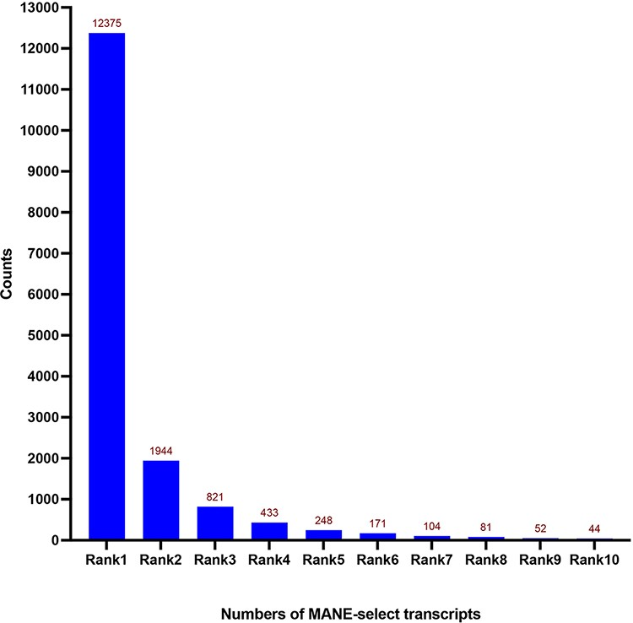
Figure 1. Distribution of expression Ranks (Rank 1–Rank 10) of MANE select transcripts. Most of the MANE select ...
Notes:
Figure 1. Distribution of expression Ranks (Rank 1–Rank 10) of MANE select transcripts. Most of the MANE select transcripts are the dominantly expressed ones—Rank 1 transcripts according to the GTEx expression dataset. Numbers of genes are shown on top of each column.
Unless provided in the caption above, the following copyright applies to the content of this slide: © The Author(s) 2022. Published by Oxford University Press.This is an Open Access article distributed under the terms of the Creative Commons Attribution-NonCommercial License (https://creativecommons.org/licenses/by-nc/4.0/), which permits non-commercial re-use, distribution, and reproduction in any medium, provided the original work is properly cited. For commercial re-use, please contact journals.permissions@oup.com

Slide 2
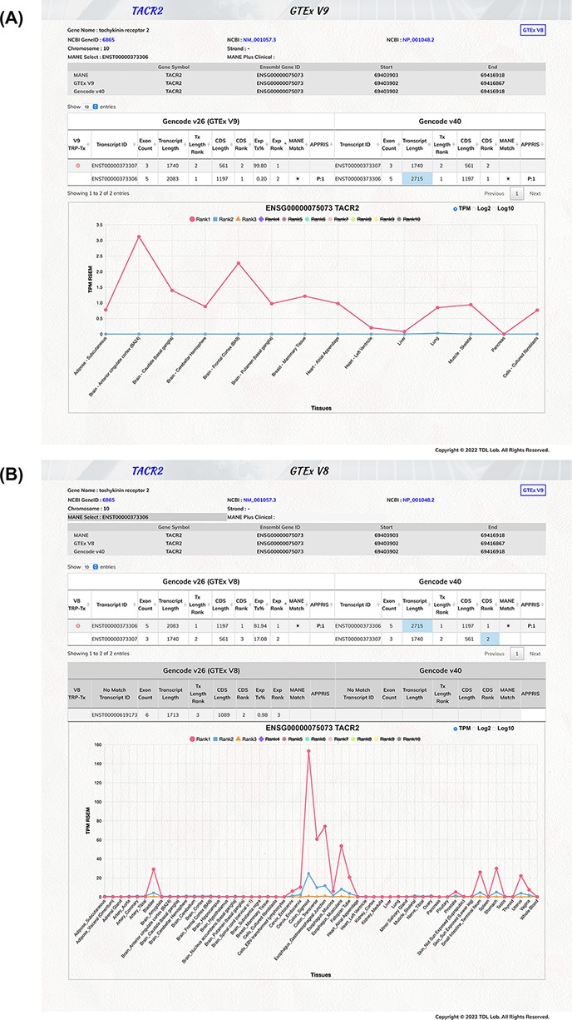
Figure 2. Illustration of TEx-MST gene information webpage for tachykinin receptor 2 (TACR2) protein-coding gene. Basic ...
Notes:
Figure 2. Illustration of TEx-MST gene information webpage for tachykinin receptor 2 (TACR2) protein-coding gene. Basic gene and transcript information of the protein-coding gene are provided. The main transcript expression data table is displayed to provide the GTEx and GENCODE information. The top-ranked protein-coding transcript is marked by a red circle and the MANE select transcript is marked by a star symbol. The important expression graph is provided for Rank 1 to Rank 10 transcripts at the bottom chart of the webpage. (A) GTEx V9 (long-read) expression information is displayed; (B) GTEx V8 (short-read) expression information is displayed. Please note that there are more tissue types in the V8 dataset. The TACR2 gene is mostly expressed in the digestive system.
Unless provided in the caption above, the following copyright applies to the content of this slide: © The Author(s) 2022. Published by Oxford University Press.This is an Open Access article distributed under the terms of the Creative Commons Attribution-NonCommercial License (https://creativecommons.org/licenses/by-nc/4.0/), which permits non-commercial re-use, distribution, and reproduction in any medium, provided the original work is properly cited. For commercial re-use, please contact journals.permissions@oup.com

Slide 3
Figure 3. The TEx-MST database web page. We have established a web resource for accessible interrogation on individual ...
Notes:
Figure 3. The TEx-MST database web page. We have established a web resource for accessible interrogation on individual MANE select transcripts. There are 19 062 protein-coding gene records in current V1.0 release of MANE project. We further classified them into four categories: (i) matched with GTEx V9 top-ranked protein-coding transcripts—13 245; (ii) not-matched with GTEx V9 top-ranked protein-coding transcripts—3153; (iii) not included in the GTEx V9 transcript list—1685 and (iv) genes not found in the GTEx dataset. A simple user guide is provided for easy access, and users can study the gene of their interests by searching with the gene symbol.
Unless provided in the caption above, the following copyright applies to the content of this slide: © The Author(s) 2022. Published by Oxford University Press.This is an Open Access article distributed under the terms of the Creative Commons Attribution-NonCommercial License (https://creativecommons.org/licenses/by-nc/4.0/), which permits non-commercial re-use, distribution, and reproduction in any medium, provided the original work is properly cited. For commercial re-use, please contact journals.permissions@oup.com

