Slide 1
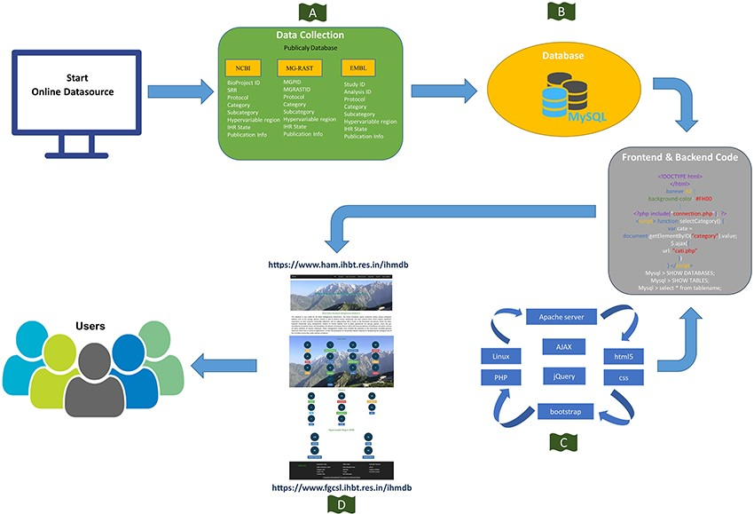
Figure 3. Schematic representation of the IHM-DB. (A) Data collection from publicly available database (NCBI, MG-RAST ...
Notes:
Figure 3. Schematic representation of the IHM-DB. (A) Data collection from publicly available database (NCBI, MG-RAST and EMBL). (B) Storage of all the collected datasets information’s into MySQL database. (C) Languages used for developing the IHM-DB. (D) User-friendly interface of the IHM-DB.
Unless provided in the caption above, the following copyright applies to the content of this slide: © The Author(s) 2023. Published by Oxford University Press.This is an Open Access article distributed under the terms of the Creative Commons Attribution License (https://creativecommons.org/licenses/by/4.0/), which permits unrestricted reuse, distribution, and reproduction in any medium, provided the original work is properly cited.

