Slide 1
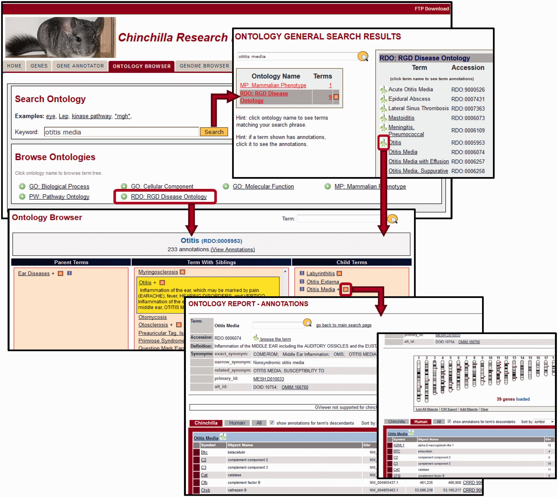
Figure 3. Ontology Browser and Search. Genes with related functional attributes can be retrieved using the CRRD ...
Notes:
Figure 3. Ontology Browser and Search. Genes with related functional attributes can be retrieved using the CRRD Ontology Browser and Search Tool. A keyword search in the tool will return a scoreboard listing the ontologies with matching terms (top). Select an ontology to see the list of matched terms, to access an ontology report or to begin browsing at a specific term. Alternatively, users can utilize the ontology browser, accessed from the name of the ontology on the main search page or by clicking a leaf icon on the search results page, to navigate up or down the tree to find their term of interest (middle). CRRD Ontology Report pages, accessed via the ‘A’ icon in the browser or the term in the search results, display details of the selected term (bottom left) as well as lists of chinchilla, human or all genes annotated to the selected term and/or its more specific child terms. In addition to the gene list, human genes are graphically displayed at their positions relative to the human karyotype (bottom right) in a whole-genome display on the human-specific results page.
Unless provided in the caption above, the following copyright applies to the content of this slide: © The Author(s) 2016. Published by Oxford University Press. This is an Open Access article distributed under the terms of the Creative Commons Attribution License ( http://creativecommons.org/licenses/by/4.0/ ), which permits unrestricted reuse, distribution, and reproduction in any medium, provided the original work is properly cited.

