Slide 1
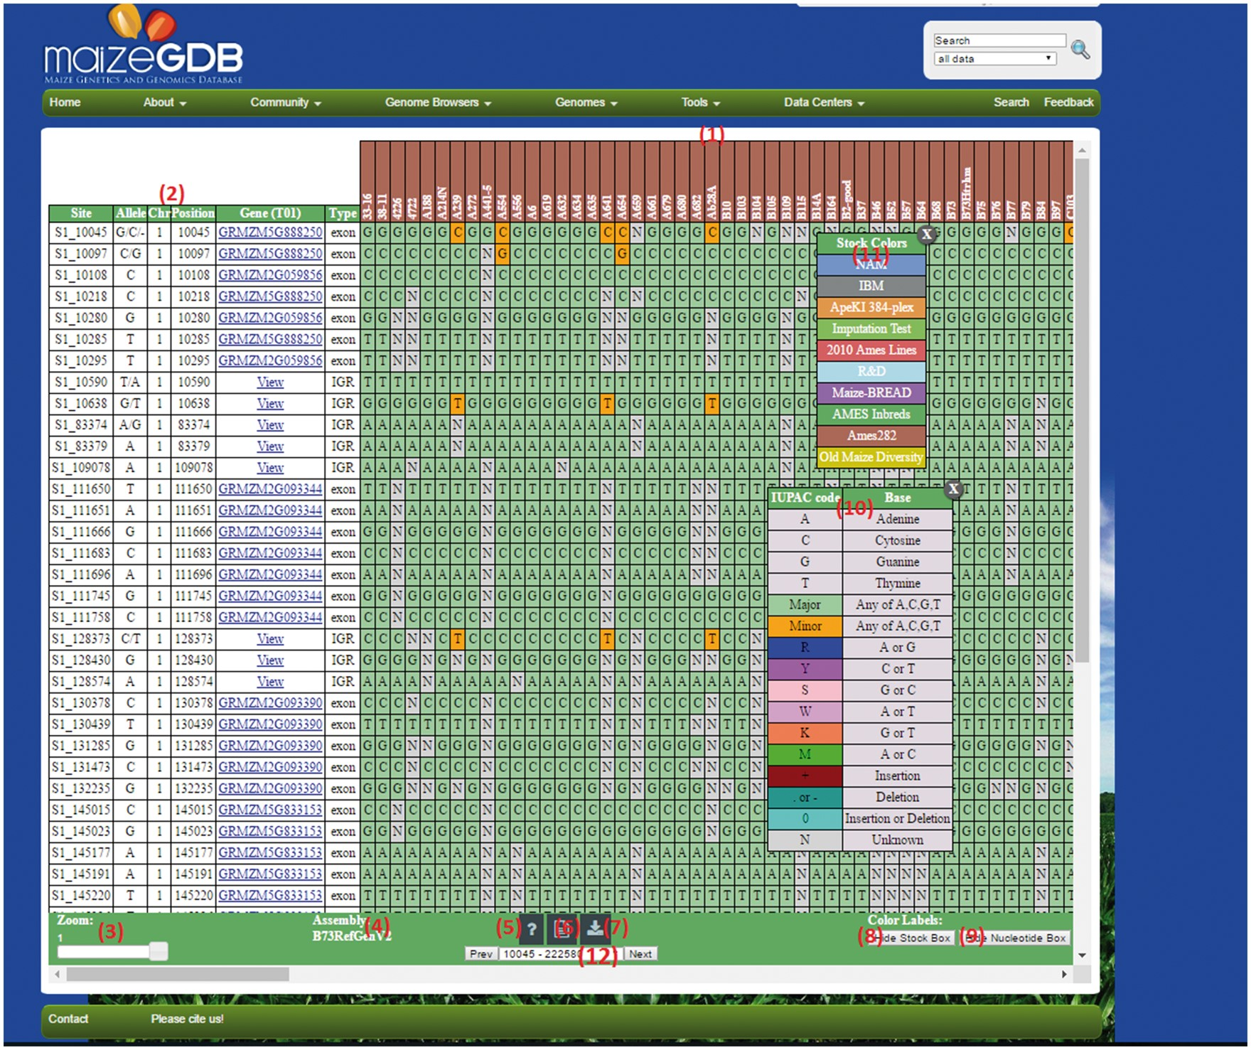
Figure 3. An example SNPversity output page. The output page is designed with contrasting colors to facilitate an ...
Notes:
Figure 3. An example SNPversity output page. The output page is designed with contrasting colors to facilitate an intuitive understanding of SNP characteristics and differences. The output shows when ‘Medium’ quick example is selected. The colors represent and differentiate major and minor allelic differences: green—major allele, orange—minor allele, red—insertion, aqua—deletion, and grey—unknown value. Please see text for further details.
Unless provided in the caption above, the following copyright applies to the content of this slide: Published by Oxford University Press 2018. This work is written by US Government employees and is in the public domain in the US.This article is published and distributed under the terms of the Oxford University Press, Standard Journals Publication Model (https://academic.oup.com/journals/pages/about_us/legal/notices)

