Slide 1
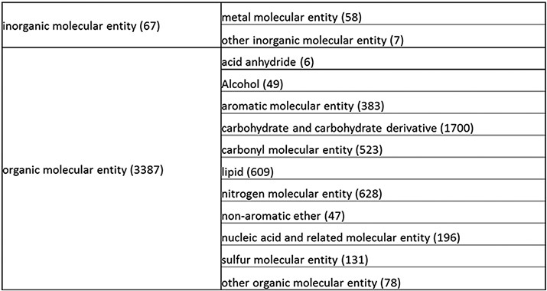
Figure 1. Overall structure of the revised chemical tree whereby the highest level is subdivided into organic and ...
Notes:
Figure 1. Overall structure of the revised chemical tree whereby the highest level is subdivided into organic and inorganic chemicals. The inorganic and organic branches are further subdivided into the most prominent and intuitive categories. The number of entries per level is indicated at the end of each branch’s label.
Unless provided in the caption above, the following copyright applies to the content of this slide: © The Author(s) 2021. Published by Oxford University Press.This is an Open Access article distributed under the terms of the Creative Commons Attribution License (http://creativecommons.org/licenses/by/4.0/), which permits unrestricted reuse, distribution, and reproduction in any medium, provided the original work is properly cited.

Slide 2
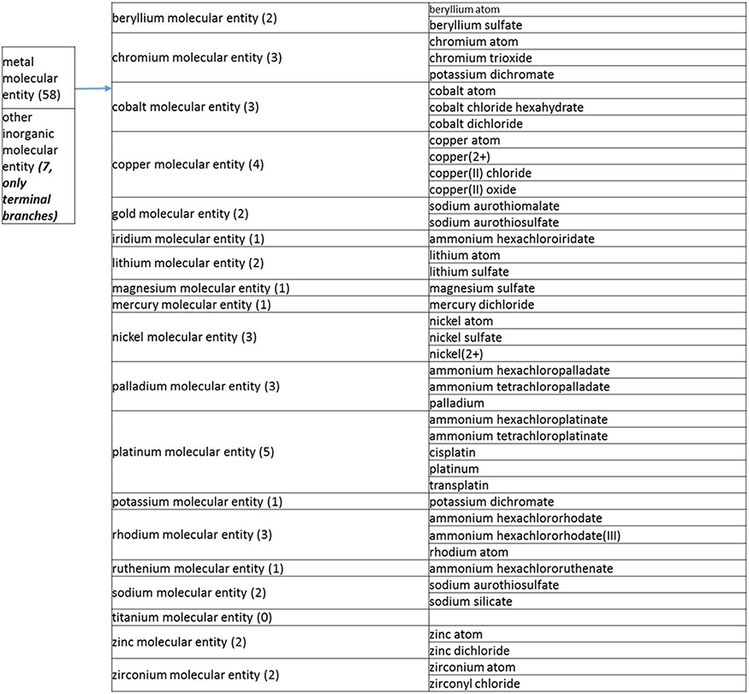
Figure 2. (a) A high-level breakdown of the inorganic molecular entity branch of the structure tree. Some of these are ...
Notes:
Figure 2. (a) A high-level breakdown of the inorganic molecular entity branch of the structure tree. Some of these are terminal branches, while others are subdivided into more specific structures for greater specificity. The number of entries per level is indicated at the end of each branch’s label.
Unless provided in the caption above, the following copyright applies to the content of this slide: © The Author(s) 2021. Published by Oxford University Press.This is an Open Access article distributed under the terms of the Creative Commons Attribution License (http://creativecommons.org/licenses/by/4.0/), which permits unrestricted reuse, distribution, and reproduction in any medium, provided the original work is properly cited.

Slide 3
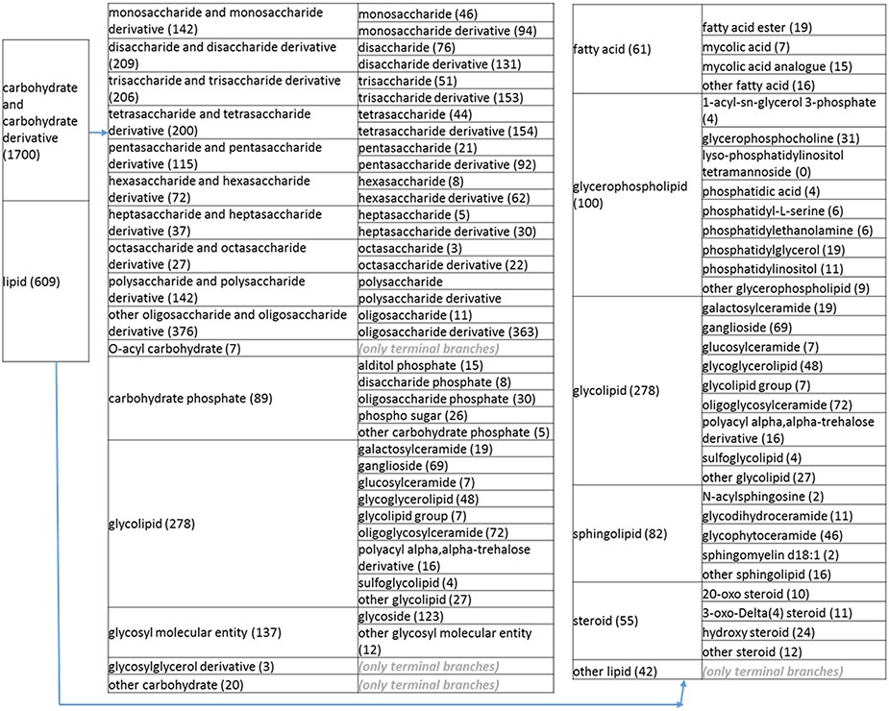
Figure 2. (b) A high-level breakdown of the carbohydrate and carbohydrate derivative, and lipid branches of structure ...
Notes:
Figure 2. (b) A high-level breakdown of the carbohydrate and carbohydrate derivative, and lipid branches of structure tree. Both of these are children of ‘organic molecular entity’. Some of these are terminal branches, while others are subdivided into more specific structures for greater specificity. The number of entries per level is indicated at the end of each branch’s label.
Unless provided in the caption above, the following copyright applies to the content of this slide: © The Author(s) 2021. Published by Oxford University Press.This is an Open Access article distributed under the terms of the Creative Commons Attribution License (http://creativecommons.org/licenses/by/4.0/), which permits unrestricted reuse, distribution, and reproduction in any medium, provided the original work is properly cited.

Slide 4
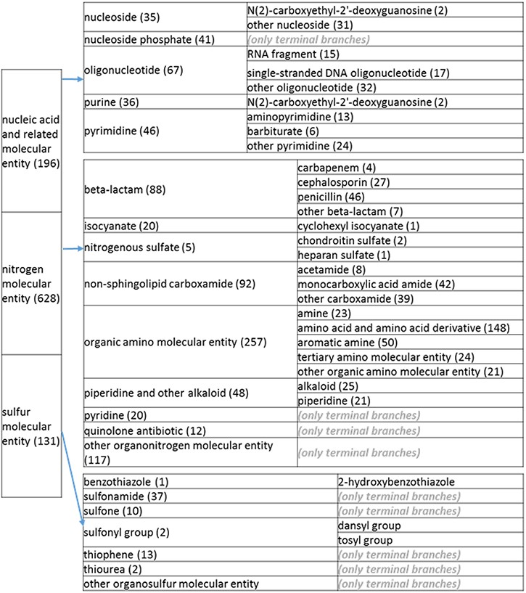
Figure 2. (c) A high-level breakdown of the nucleic acid and related molecular entity, nitrogen molecular entity, ...
Notes:
Figure 2. (c) A high-level breakdown of the nucleic acid and related molecular entity, nitrogen molecular entity, sulfur molecular entity, nitrogen molecular entity, sulfur molecular entity branches of the structure tree. All of these are the children of ‘organic molecular entity’ Some of these are terminal branches, while others are subdivided into more specific structures for greater specificity. The number of entries per level is indicated at the end of each branch’s label.
Unless provided in the caption above, the following copyright applies to the content of this slide: © The Author(s) 2021. Published by Oxford University Press.This is an Open Access article distributed under the terms of the Creative Commons Attribution License (http://creativecommons.org/licenses/by/4.0/), which permits unrestricted reuse, distribution, and reproduction in any medium, provided the original work is properly cited.

Slide 5
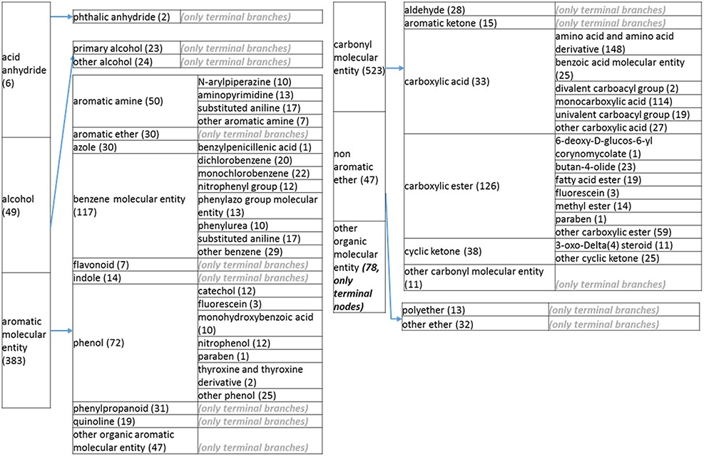
Figure 2. (d) A high-level breakdown of the acid an hydride, alcohol, aromatic molecular entity, carbonyl molecular ...
Notes:
Figure 2. (d) A high-level breakdown of the acid an hydride, alcohol, aromatic molecular entity, carbonyl molecular entity, non-aromatic ether and other molecular entity branches of the structure tree. All of these are children of ‘organic molecular entity’. Some of these are terminal branches, while others are subdivided into more specific structures for greater specific structures for greater specificity. The number of entries per level is indicated at the end of each branch branch’s label.
Unless provided in the caption above, the following copyright applies to the content of this slide: © The Author(s) 2021. Published by Oxford University Press.This is an Open Access article distributed under the terms of the Creative Commons Attribution License (http://creativecommons.org/licenses/by/4.0/), which permits unrestricted reuse, distribution, and reproduction in any medium, provided the original work is properly cited.

Slide 6
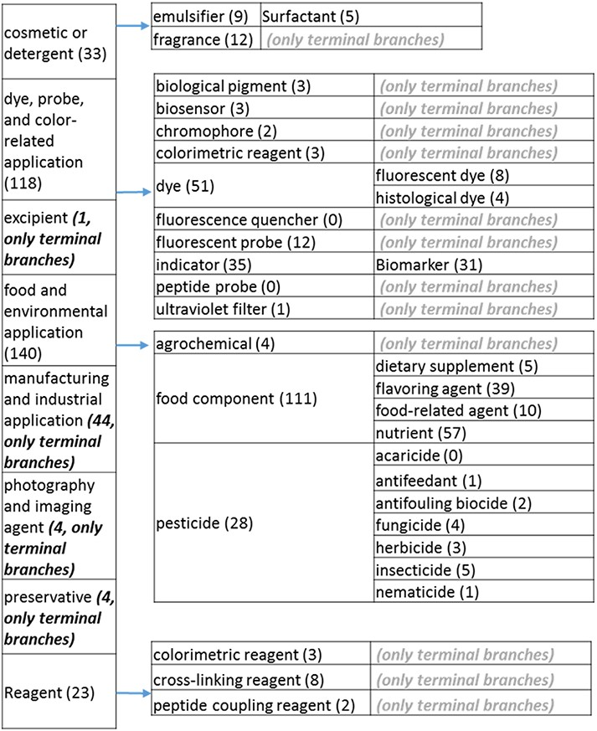
Figure 3. (a) The ‘application’ role class of the revised role tree, excluding the drug branch, which is further ...
Notes:
Figure 3. (a) The ‘application’ role class of the revised role tree, excluding the drug branch, which is further subcategorized into the most prominent application. Some of these are terminal branches, while others are subdivided into more specific application types for greater specificity. The number of entries per level is indicated at the end of each branch’s label.
Unless provided in the caption above, the following copyright applies to the content of this slide: © The Author(s) 2021. Published by Oxford University Press.This is an Open Access article distributed under the terms of the Creative Commons Attribution License (http://creativecommons.org/licenses/by/4.0/), which permits unrestricted reuse, distribution, and reproduction in any medium, provided the original work is properly cited.

Slide 7
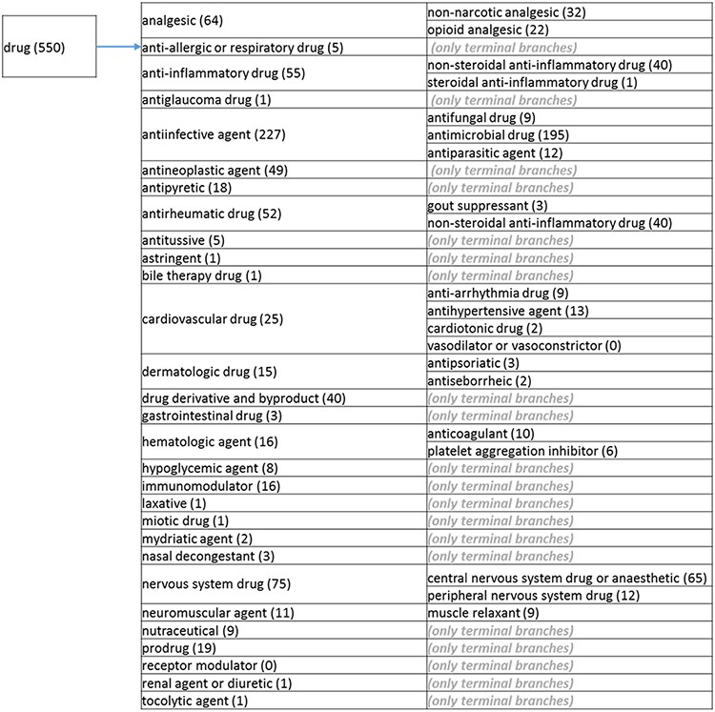
Figure 3. (b) The ‘drug’ branch of the ‘application’ role class of the revised role tree, which is further ...
Notes:
Figure 3. (b) The ‘drug’ branch of the ‘application’ role class of the revised role tree, which is further subcategorized into the most prominent applications. Some of these are terminal branches, while others are subdivided into more specific application types for greater specificity. The number of the entries per level is indicated at the end of each branch’s label.
Unless provided in the caption above, the following copyright applies to the content of this slide: © The Author(s) 2021. Published by Oxford University Press.This is an Open Access article distributed under the terms of the Creative Commons Attribution License (http://creativecommons.org/licenses/by/4.0/), which permits unrestricted reuse, distribution, and reproduction in any medium, provided the original work is properly cited.

Slide 8
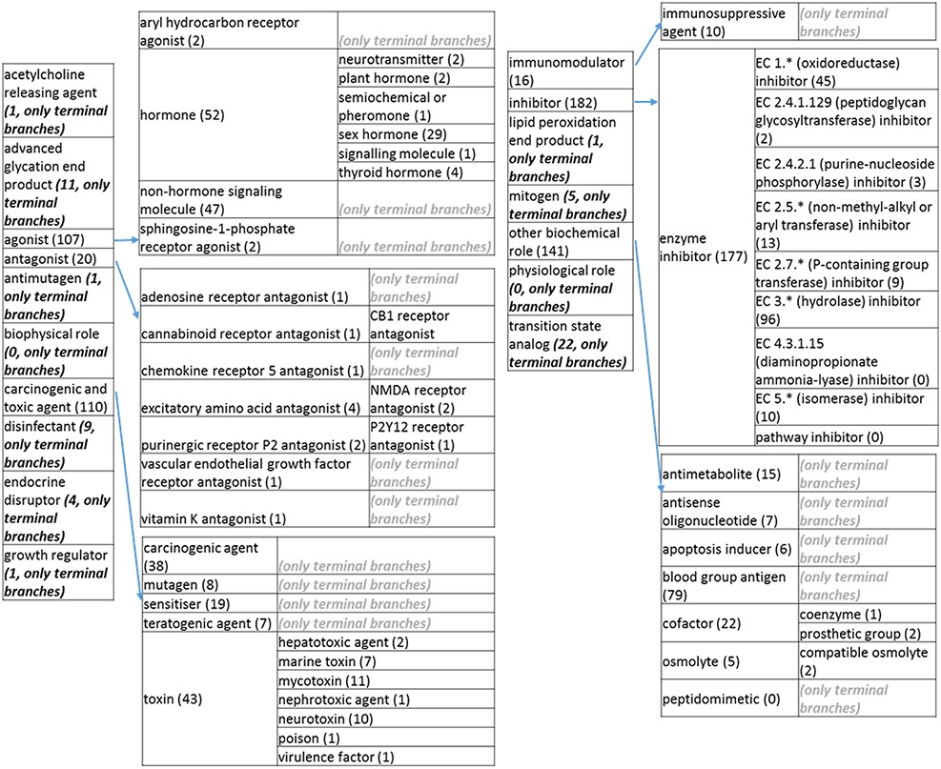
Figure 3. (c) The ‘biological role classes of the revised role tree, which is further subcategorized into the most ...
Notes:
Figure 3. (c) The ‘biological role classes of the revised role tree, which is further subcategorized into the most prominent biological functions. Some of these are terminal branches, while others are subdivided into more specific biological role types for greater specificity. The number of entries per level is indicated at the end of each branch’s label.
Unless provided in the caption above, the following copyright applies to the content of this slide: © The Author(s) 2021. Published by Oxford University Press.This is an Open Access article distributed under the terms of the Creative Commons Attribution License (http://creativecommons.org/licenses/by/4.0/), which permits unrestricted reuse, distribution, and reproduction in any medium, provided the original work is properly cited.

Slide 9
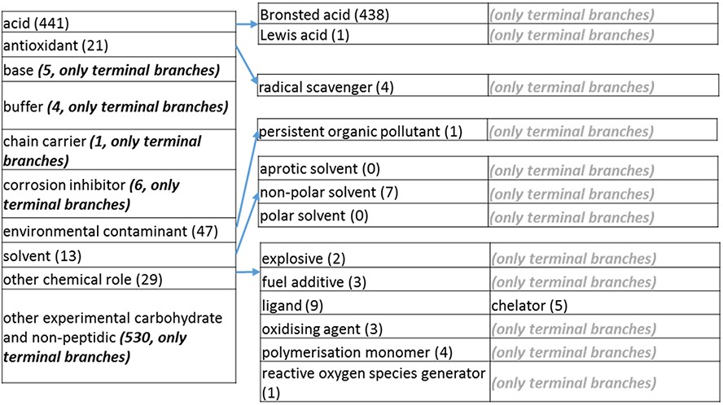
Figure 3. (d) The ‘chemical role’ role class of the revised role tree, which is further subcategorized into the most ...
Notes:
Figure 3. (d) The ‘chemical role’ role class of the revised role tree, which is further subcategorized into the most prominent chemical roles. Some of these are terminal branches, while others are subdivided into more specific chemical roles. Some of these are terminal branches, while others are subdivided into more specific chemical role types for greater specificity. The number of number of entries per level is indicated at the end of each branch’s label.
Unless provided in the caption above, the following copyright applies to the content of this slide: © The Author(s) 2021. Published by Oxford University Press.This is an Open Access article distributed under the terms of the Creative Commons Attribution License (http://creativecommons.org/licenses/by/4.0/), which permits unrestricted reuse, distribution, and reproduction in any medium, provided the original work is properly cited.

Slide 10
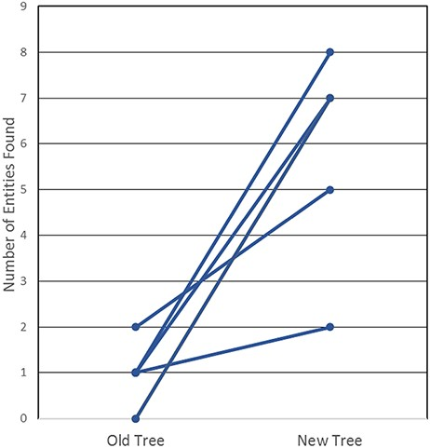
Figure 4. User testing comparison of old and new non-peptidic trees, where users were tasked in locating 20 ...
Notes:
Figure 4. User testing comparison of old and new non-peptidic trees, where users were tasked in locating 20 non-peptidic entities across the two trees while being timed. Statistical significance was achieved with P < 0.005, as all participants consistently located more entities in the new tree.
Unless provided in the caption above, the following copyright applies to the content of this slide: © The Author(s) 2021. Published by Oxford University Press.This is an Open Access article distributed under the terms of the Creative Commons Attribution License (http://creativecommons.org/licenses/by/4.0/), which permits unrestricted reuse, distribution, and reproduction in any medium, provided the original work is properly cited.

