Slide 1
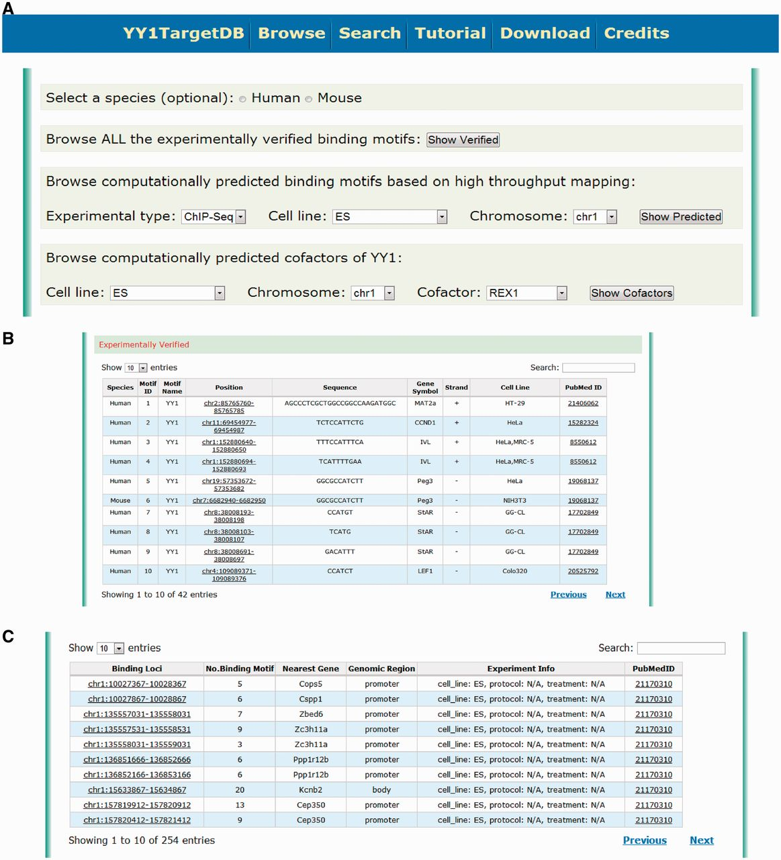
Figure 2 Screen shot depicting the browsing interface. (A) Web interface for browsing the experimentally verified or ...
Notes:
Figure 2 Screen shot depicting the browsing interface. (A) Web interface for browsing the experimentally verified or computationally predicted YY1-binding motif. (B) Tabulated presentation for experimentally verified YY1-binding motifs. A hyperlink was implemented for further data visualization. (C) Tabulated presentation for identified YY1-binding loci. A hyperlink was implemented for further visualization of computationally predicted YY1-binding motifs under each locus.
Unless provided in the caption above, the following copyright applies to the content of this slide: © The Author(s) 2013. Published by Oxford University Press.This is an Open Access article distributed under the terms of the Creative Commons Attribution Non-Commercial License (http://creativecommons.org/licenses/by-nc/3.0/), which permits unrestricted non-commercial use, distribution, and reproduction in any medium, provided the original work is properly cited.

